Slide 1
Data Management Plan for FIREX-AQ Airborne Field Study
Gao Chen
NASA Langley Research Center
Ken Aikin
NOAA Earth System Research Laboratory

Slide 2
FIREX-AQ Data Repositories
Current Plan:
NOAA Data Repository: esrl.noaa.gov/csd/projects/firex-aq
NOAA TwinOtter-CHEM, TwinOtter-MET, and NightFOX
NASA Data Repository: www-air.larc.nasa.gov
NASA DC-8 and ER-2
Ground mobile labs
Trajectories, model results, satellite
WE-CAN final data and merges
NOAA TwinOtter-CHEM, TwinOtter-MET, and NightFOX Final data
Data repositories will have common access control and be cross-linked
Username: ............ Password: ……..…..

Slide 3
FIREX-AQ Data Submission Schedule
Mission Phase | Data Type | Submission Deadline | Access Control
Field Deployment | Field Data | 24 hour after each flight or cal. Day | Science team and Partners
Post-Deployment | Final Data | May 2, 2020 | Public
Field data submission deadline may vary depending on field operation constraints
The final data should be of publication quality and time synched to the time standard for each platform

Slide 4
FIREX-AQ Data Format Requirements
The data from FIREX-AQ field study will conform to ICARTT, netCDF, or HDF format
All in-situ measurements are required to report data in ICARTT format. Detailed format description can be found at: http://www-air.larc.nasa.gov/missions/etc/IcarttDataFormat.htm.
All incoming data files from in-situ measurements will be scanned to ensure compliance to the ICARTT format requirements. A common file scanner will be used for both data repository
Assistance will be made available to the science team to troubleshoot issues in generating ICARTT files.
The remote sensing measurement instruments and models may report data in either HDF, netCDF, or ICARTT format

Slide 5
FIREX-AQ Data Reporting I
FIREX-AQ Metadata Requirements:
The FIREX-AQ data files should be self-describing through information on: variable definition, unit, data reporting information, measurement description, measurement uncertainty and detection limits
The metadata requirements are uniform for all file formats
FIREX-AQ requires standardized instrument description
DataID Registration:
PI will need to register his/her dataID(s) before file submission, which is used to organize files on the data repository and is a part of the FIREX-AQ file naming convention.
DataID, prefixed by FIREXAQ, is a typically short description of measured parameter/species, instrument, or model (e.g., FIREXAQ-O3).
The website is open for dataID registration; detailed instructions will be distributed.

Slide 6
FIREX-AQ Data Reporting II
Use the same number of variables and variable names throughout mission for the files with the same same dataID
Measurement Time Reporting:
Use fixed variable name(s) for Time Stamps, i.e., Time_Start, Time_Stop, and Time_Mid
Use start, stop, and mid times if integration interval larger than 1 sec
Use one time stamp (Time_Start or Time_Stop) for data at ≥ 1 Hz
Data Interval = actual value for constant interval data
Data Interval = “-1” for irregular interval data – Contact Ali or Gao
Use “Special Comments” to indicate if the measurement time is synched to the time standard
Indicate trace gas is reported in dry or ambient condition and report absolute concentration and aerosol extensive properties at STP: 273K and 1013 mb
Consider to use “common” attributes for HDF and netCDF file, at least for similar models or instruments
Add variable standard names in the variable definition line

Slide 7
Variable Standard Names
tags, NOT short names:
short name, unit, standard name, long name
CH2O_pptv, pptv, Gas_CH2O_insitu_S_AVMR, mixing ratio by volume CH2O_LOD_pptv, pptv, Gas_CH2O_insitu_S_AVMR, Limit of Detection
NOy_pptv, pptv, Gas_NOyasNO_insitu_M_AVMR, Total Reactive Nitrogen Mixing Ratio
Sc700_total, Mm-1, AER_Scattering_insitu_red_RHd_Total_AMB, Dry Scattering at 700nm (Total Aerosols)
Standard Name Structure:
MeasMedium_CoreName_MeasMode_DescriptiveAttributes
intended to help data discovery and machine readability (i.e., shared vocabulary)
divided into 6 categories: Trace Gas, Aerosol, Cloud, Radiation, j Values, Nav and Met
complete list will be available on the data website
Looking for feedback to improve the current list

Slide 8
FIREX-AQ Data File Naming Convention
DataID_LocationID_YYYYMMDD_R#_Description.extension
DataID: a short description of measured parameter/species, instrument, or model
LocationID: an identifier of measurement platform: e.g. DC8, will be provided on the website in a drop-down box
YYYYMMDD: UTC date when the flight take off or the beginning of the measurement for ground sites
R#: Revision number. The revision number will be RA, RB, RC, … for field data and R0, R1, R2, … for the final data. Note: archived files cannot be overwritten
Description: optional additional description of the file if necessary
Extension: “ict” for ICARTT files, “h4” for HDF 4 files, and “h5” for HDF 5 files, etc.
Examples: the filename for DC-8 diode laser spectrometer H2O measurement made on May 1, 2016 flight may be:
FIREXAQ-DLH-H2O_DC8_20190801_RA.ICT (for field data)
FIREXAQ-DLH-H2O_DC8_20190801_R0.ICT (for final data)

Slide 9
in-situ Sampling Time Standards
DC-8: DLH H2O (20 and 1 Hz), DACOM CO and CO2 (5 - 10 Hz, TBD, and 1 Hz)
NSRC and MMS will provide 20 Hz aircraft location data
CHEM-TwinOtter: NO2
MET-TwinOtter: GPS

Slide 10
Standardized Instrument Description
Instrument | CalibratingMethod
ResponsibleParty | CalibrationStandard
ValidPeriod | CalibrationLog
MeasurementVariables | samplingStrategy
TimeSyncOrigin | samplingTreatment
Manufacturer/Developer | samplingTreatmentDescription
MeasurementUncertainty | samplingProcedure
ObservableRange | samplingProcedureDescription
ObservingMethod | DataProcessing
ObservingMethodDetail | softwareDetails
ObservingMethodReference | DataReportingInformation
Intend to post the standardized forms on the data website
Should take <2 – 3 hours for one instrument and should be re-usable for later missions with minor changes
Description of and examples for in-situ instruments and HSRL-DIAL will be available on the data website

Slide 11
FIREX-AQ Science Data Policy
All participants are requested to accept the following responsibilities:
Submit data in ICARTT, netCDF or HDF format no later than the deadlines
If unexpected events lead to any delay in data submission, the PI is required to notify the project leadership as soon as issues are known
Final data should be submitted to the archive prior to any presentation at scientific conferences (e.g. AGU, AMS) or manuscript preparation, unless explicit authorization is obtained from the program managers
All aircraft measurements from a common platform should be synchronized to science team pre-agreed time standard
Consult with PIs when using their data in conference/data workshop presentations and/or manuscript
Invite PIs of any data used to be co-authors (particularly during post-deployment research phase)
PIs should be available to answer questions about their data

Slide 12
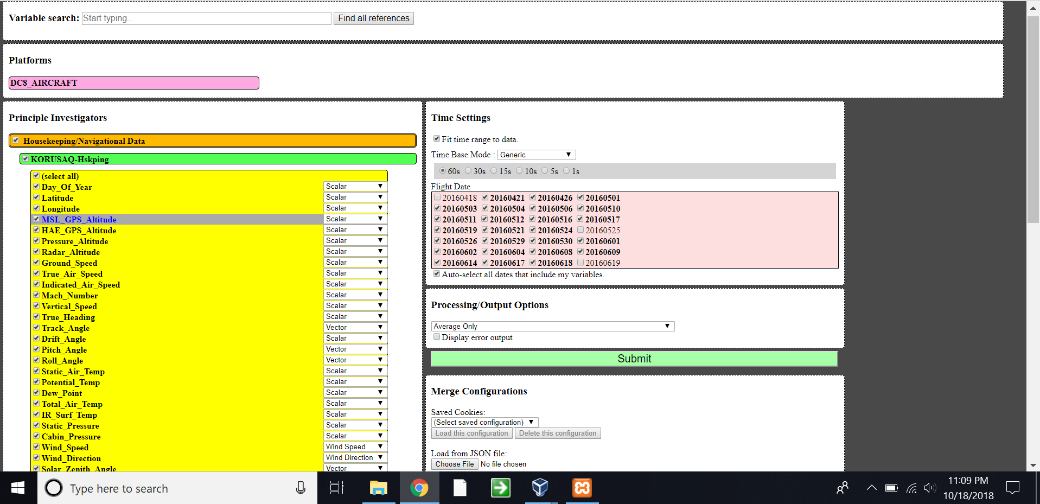
FIREX-AQ Data Merge: Online Merge Option
Online merge code will be tested by the science team during FIREX-AQ period
Allow custom-choice of variables, variable type, merge time scale, output options (average only, average with standard deviation…)
Able to save and load configuration file
Standard project merge will be generated at LaRC and made available to science team

Slide 13
Data Managers
The KORUS-AQ Data Manager will monitor the data submission status in accordance with the data submission timeline. The data manager will also coordinate the efforts to support implementation of ICARTT format
Gao Chen, NASA Langley Research Center, gao.chen@nasa.gov, 757-864-2290
Ken Aikin, NOAA Earth Science Research Laboratory
kenneth.c.aikin@noaa.gov, 303-497-7051

