Slide 1

Data Management for ACT-America
Bob Cook¹, Gao Chen², Yaxing Wei¹, and Thomas Lauvaux³
¹Oak Ridge National Laboratory
²NASA Langley
³Penn State
Notes:
Gao Chen from Langley
Yaxing from ORNL and
Thomas Lauvaux from Penn State

Slide 2
Roadmap
Introduction
Science Data Working Group
Observation data – Gao Chen
Integration of observations and model output
Goals for this meeting

Slide 3
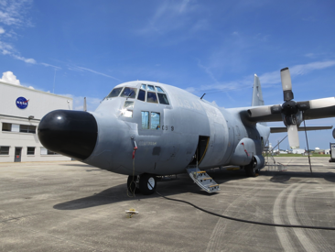
Notes:
This chart shows the flow of data within ACT-America—we have a more detailed flow chart as a poster. Its’ complicated: lots of groups generating data for ACT-America.
It includes airborne data compiled by Langley (in purple). These gas measurements will be complemented by gas concentrations from TCONN and OCO-2.
Priors for the inversion models will come from ecosystem modes and estimates of co2 exchange from fossil fuel emissions and fires
ORNL will have a repository for sharing data among the modeling teams
During the course of the project data will be made available to the public from both ORNL and Langley and after project data will be archived at one of ESDIS DAACs, the ORNL DAAC
? Indicate that the team needs to identify data products that will be made available to the public during the project, and products that will be archived.

Slide 4
Data Management Goals
Coordinate data management activities with instrument teams, modelers, and external data sources
Ensure data, products, and information required to address science questions are available in harmonized forms when needed
  Project repositories
  Public repository during the project
  Transfer final data to the NASA Archive – ORNL DAAC

Slide 5
Science Data Working Group: Members
Thomas Lauvaux, modeling, Lead
Ed Browell, MFLL observations
Melissa Yang, observations
Chris O’Dell, OCO-2
Andy Jacobson, CarbonTracker
Gao Chen, data management and observations
Yaxing Wei, data management and modeling
Bob Cook, data management and modeling
Ken Davis, PI for ACT-America
Bing Lin, Project Scientist for ACT-America
Mike Obland, Project Manager for ACT-America

Slide 6
Science Data Working Group:
Activities
Prepare Protocol
  Characteristics of data products
    Content, format, projection, space-time representation, variable names and units
  Plan data flow and integration (see poster)
Provide input on the features for ACT-America data repositories
  upload and download; user access control; discovery catalog; subset services
Identify data for public release during the project
Identify data to be archived at the end of the project

Slide 7
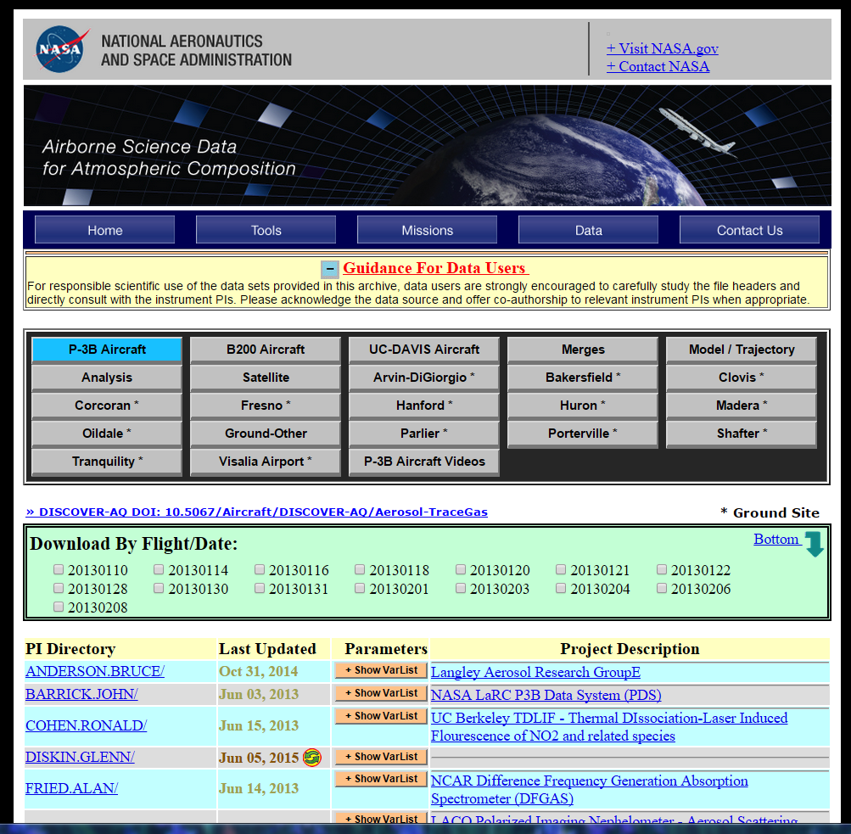
Observational Data Repository: DISCOVER-AQ example
Data repository for preliminary and final data will be set up 1 month before 1st deployment
Buttons used to identify data sources: e.g., aircraft and ground sites
DISCOVER-AQ Data DOI
List of flight dates to allow download of all data from the same flight
Data files are organized based on Co-I names
Variable names can be viewed without opening actual data files

Slide 8
ACT-America Observational Data Schedule
Preliminary Data:
  1 day after each flight for aircraft measurements
  1 day for ground sites
  Exceptions: back-to-back flights and flask measurements
Final Data:
  6 months after the end of each deployment and publically available
Final Data will be transferred to ORNL DAAC
  beginning in 4th project year
Documentation material (Level 0 Data):
  Primary instrument output
  Data processing algorithm and codes
  Instrument description (publication) and deployment notes
  Ancillary data and other necessary information for data processing
  Documentation material will be submitted to ORNL starting from the 4th project year

Slide 9
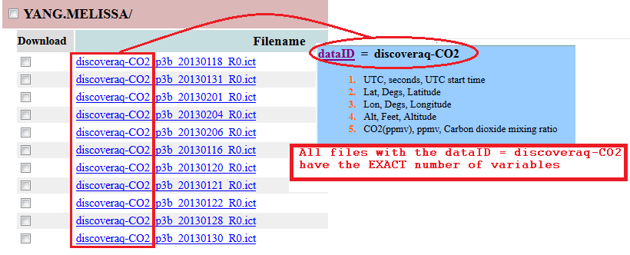
Data Format Requirements:
Best Practices
Aircraft and ground-based measurements are required to report data in either ICARTT or HDF format
File naming convention and data file submission procedures will be sent out about 1 month before the start of the first deployment
All data files for the same dataID (part of file name) should have same number of variables and the same variable names
The time variable names should indicate if they represent the beginning, mid, or end of the sampling period by using “_start”, “_mid” or “_stop” suffix, e.g., UTC_start
The file scanner will verify these requirements for ACT-America
Timely support will be provided for dataID registration, data format trouble-shooting, data file name issues, and data download problems. Please contact Gao Chen (gao.chen@nasa.gov, 757-864-2290), Ali Aknan (ali.a.aknan@nasa.gov) and Michael Shook (michael.a.shook@nasa.gov)

Slide 10
Documentation Material Example
Project Requirements:
  “By the Investigation Closeout, the [Co-I] shall deliver all data products, along with the scientific algorithm software, coefficients, and ancillary data used to generate these products, to the [ORNL Distributed Active Archive Center]”
  The primary goal is to maintain reprocessing capability by the Co-Is
DISCOVER-AQ Example for Licor CO2 measurement:
  Digitized instrument output from Licor and flow, temperature, and pressure data
  Data processing code
  Deployment notes about inlet and flow configuration
  Publication citation about instrument working principle and description of instrument and measurement
  All information compiled into four zipped files (one for each deployment) and submitted to ASDC directly
ACT-America Example for Aircraft Picarro and Ozone Measurement
  Digitized Picarro and 2B Tech Ozone output (including system measurements such as system pressure, flow, temperature)
  Data processing code
  Description of instrument and measurement

Slide 11
Integration of observations and model output
GHG inversion system
Transport model
GHG measurements
A priori fluxes

Slide 12
Integration of observations and model output
GHG measurements:
Surface in-situ (NOAA,, ACT)
Surface column (TCCON)
Space missions (OCO-2, GOSAT)
Aircraft in-situ (NOAA, ACT)
Aircraft column (ACT)
Meteo measurements
Surface stations (WMO, MADIS)
Profiles (WMO, profilers, MADIS, ACT)
Global transport models:
  GEOS-5
  PCTM
  TM5
  CSU
Regional transport models:
  TM-5 (N.Am. 1x1 degree)
  GEOS-5 (0.5x0.6 degree)
  WRF-PSU (N.Am. 30km)
  WRF-AER?
  SPRING
Inventory data:
Fossil fuel
Fires
Chemistry
Ocean
Biogenic fluxes:
ecosystem models
inversion products
GHG inversion system
Transport model
GHG measurements
A priori fluxes

Slide 13
Integration of observations and model output
Characteristics:
3D (Along ACT flight path)
2D (Global space missions)
1D (Surface locations)
2D (Vertical profiles)
Format: variable
Characteristics:
3D Global or N.Am.
2D Global or N.Am.
Extract: Along flight path or at selected locations
Format: netcdf
Model meta-data
Characteristics:
3D Global or N.Am.
2D Global or N.Am.
Format: netcdf
GHG inversion system
Transport model
GHG measurements
A priori fluxes

Slide 14
Data Characteristics (1 of 2)

Slide 15
Data Characteristics (2 of 2)
WRF-CO2
WRF-CMS
PCTM

Slide 16
Goals for the Meeting
Review large data flow chart
  Identify gaps, missing pieces, etc.
  Identify where you are on the chart
  What will you provide for the downstream person / group?
  What do you need from the upstream person
  Characteristics
        Variables, units, space-time domain, space-time resolution, file format, documentation

Slide 17
Environmental Observations and Modeling
Observations
ACT-America
Models
Data Groups
Communication among data groups, those making the measurements, and modelers is critical

Slide 18
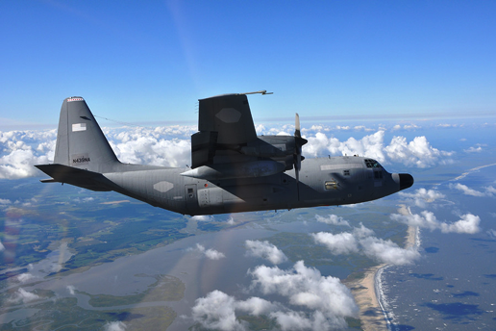
Questions?

Slide 19
ACT-America File Naming Convention
Example: the filename for the C-130 Picarro CO2 measurement made on
July, 1, 2016 flight may be:
ACTAmerica-Picarro-CO2_C130_20160701_R1.ict
File Naming Structure: dataID_locationID_YYYYMMDD_R#
The only allowed characters are: a-z A-Z 0-9_.- (that is, uppercase and lowercase
alphanumeric, underscore, period, and hyphen). Fields are described as follows:
dataID: an identifier of measured parameter/species, instrument, or model (e.g., O3 and Flask). For ACT-America data files, the Co-Is are required to use “ACTAmerica_” as prefixes for their DataIDs, i.e., ACTAmerica_O3, and ACTAmerica_Flask.
locationID: an identifier of airborne platform or ground site, e.g., C-130. Specific locationIDs for each deployment will be provided on the ACT-America data repository website.
YYYY: four-digit year
MM: two-digit month
DD: two-digit day (for flight data, the date corresponds to the UT date at take off)
R#: data revision number. For preliminary data, revision number will start from letter “A”, e.g., RA, RB, … etc. Numerical values will be used for the final data, e.g., R1, R2, R3 … etc.
extension: “ict” will be the file extension for ICARTT files, “h5” will denote HDF5 files

Slide 20
Merged Data Example
Merged files created for each aircraft and contain all measurement ICARTT variables, including the aircraft location and ambient meteorological data
Data merges are created by averaging/interpolating Co-I data based on the overlap between the Co-I sampling intervals and merged time base
Merged files will be for both preliminary and final data
Merged files will be updated to reflect data revisions on the repository
plan to make 1-second, 60- second, and flask sampling time merges. Other time intervals will be done upon science team requests.
Co-I data
60 second merged data

