Slide 1
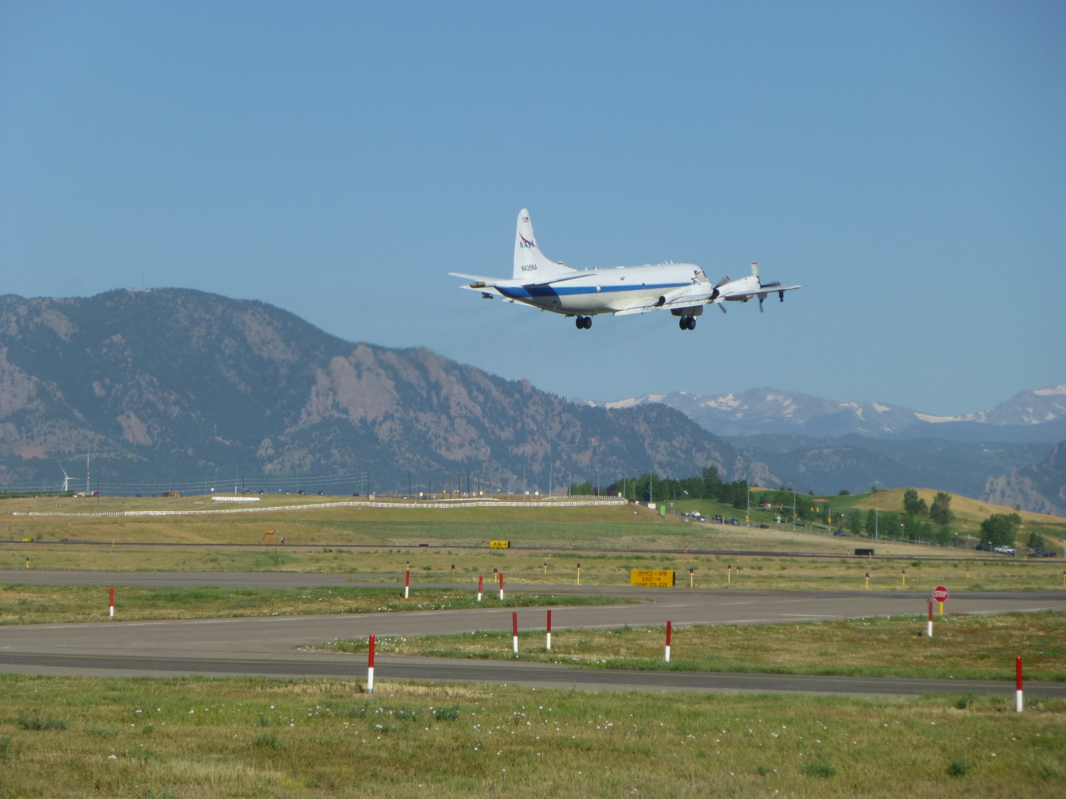
An Overview of Ozone and Precursor Temporal and Spatial
Variability in DISCOVER-AQ Study Regions
Ken Pickering, NASA Goddard Scott Janz, NASA Goddard
James Crawford, NASA Langley Lok Lamsal, GESTAR/GSFC
Melanie Follette-Cook, GESTAR/GSFC Morgan Silverman, SSAI/LaRC
Chris Loughner, UMD/GSFC Deb Stein-Zweers, GESTAR/GSFC
Clare Flynn, UMD James Szykman, EPA/LaRC
Rich Clark, Millersville U. Andy Weinheimer, NCAR
Alan Fried, U. of Colo.
Jay Herman, UMBC/GSFC

Slide 2
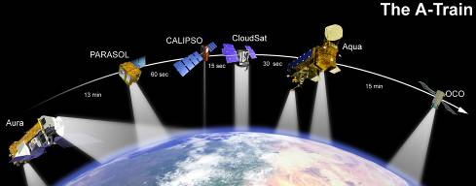

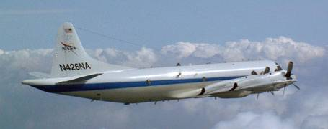
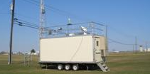
DISCOVER-AQ Overview
Deriving Information on Surface Conditions from Column
and VERtically Resolved Observations Relevant to Air Quality
A NASA Earth Venture campaign intended to improve the interpretation of satellite observations to diagnose near-surface conditions relating to air quality
Objectives:
1. Relate column observations to surface conditions for aerosols and key trace gases O₃, NO₂, and CH₂O
2. Characterize differences in diurnal variation of surface and column observations for key trace gases and aerosols
3. Examine horizontal scales of variability affecting satellites and model calculations
NASA King Air
NASA P-3B
Deployments and key collaborators
Maryland, July 2011 (EPA, MDE, UMd, and Howard U.)
SJV, California, January/February 2013 (EPA and CARB)
Houston, Texas, Sept. 2013 (EPA, TCEQ, and U. of Houston)
Front Range, Colorado, Summer 2014 (EPA, NCAR, CDPHE)
NATIVE, EPA AQS, and associated Ground sites
Notes:
DISCOVER-AQ is a 5-year, $30M airborne field study funded under NASA’s Earth Venture 1 program. The goals of the program are intended to shed light on challenges in observing air quality from space. Results are expected to be of direct benefit to GEO-CAPE planning and development.

Slide 3
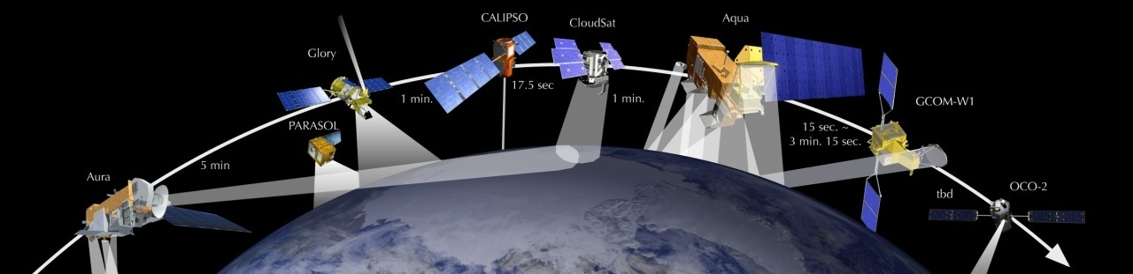
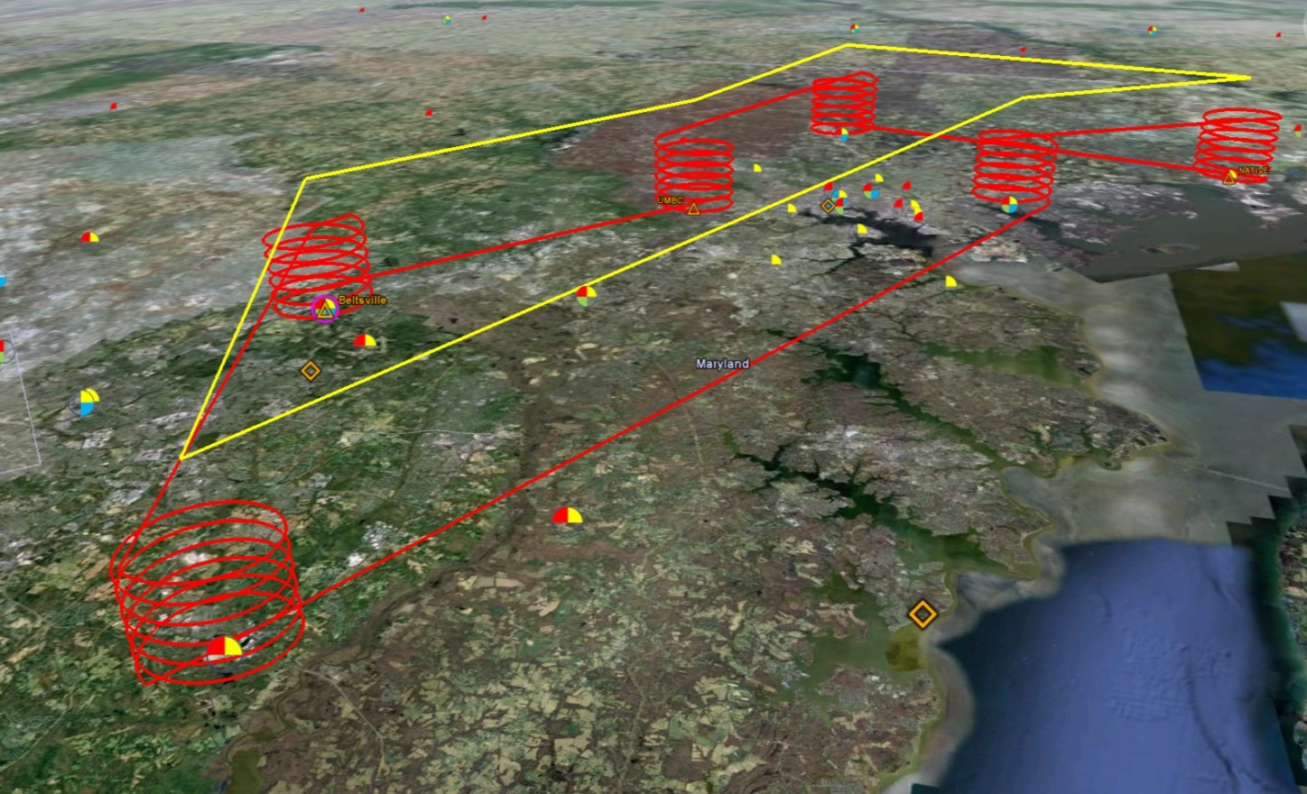
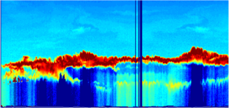

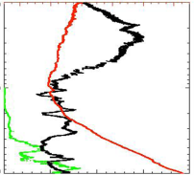
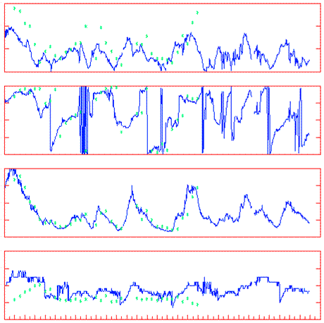
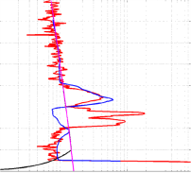
Deployment Strategy
Systematic and concurrent observation of column-integrated, surface, and vertically-resolved distributions of aerosols and trace gases relevant to air quality as they evolve throughout the day.
Three major observational components:
NASA KingAir (Remote sensing)
Continuous mapping of aerosols with HSRL and trace gas columns with ACAM
NASA P-3B (in situ meas.)
In situ profiling of aerosols and trace gases over surface measurement sites
Ground sites
In situ trace gases and aerosols
Remote sensing of trace gas and aerosol columns (Pandora, AERONET)
Ozonesondes, tethersonde
Aerosol lidar observations
Notes:
The density and simultaneity of observations from different perspectives is a key aspect of DISCOVER-AQ in creating a dataset useful for linking remote sensing and in situ observations of air quality.

Slide 4
Spatial and Temporal
Variability
Follette-Cook et al. - manuscript in preparation for Atmos. Environ.
We want to use regional chemical model output to help us quantify the variability that a geostationary instrument (e.g. TEMPO) would observe.
Is the resolvable variability sufficient to answer the relevant science questions for the proposed geostationary instruments?
First, we quantify the variability seen in the DISCOVER-AQ P-3B trace gas data and compare with our WRF/Chem simulation
Does WRF/Chem do a reasonable job reproducing the variability seen during the DISCOVER-AQ campaign?
ƒ(Z, y) ≡ <⏐Z(x + y) - Z(x)⏐>
Where < > denotes the average of data pairs separated by distance (or time) y, Z is the variable of interest at a given location x.
Notes:
Put satellite in motivation

Slide 5
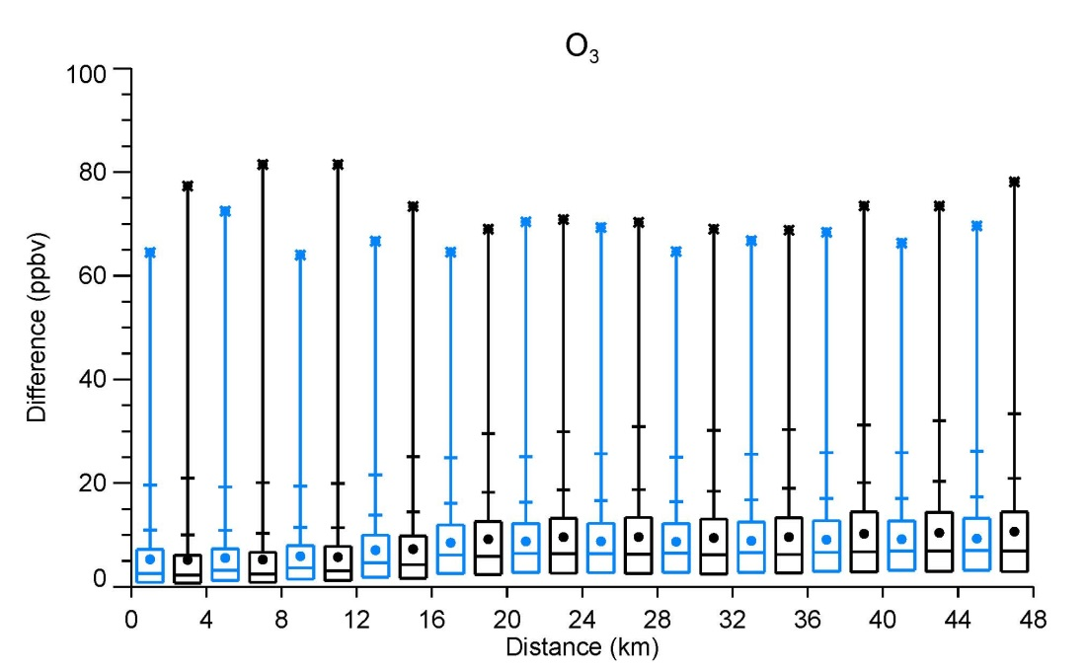
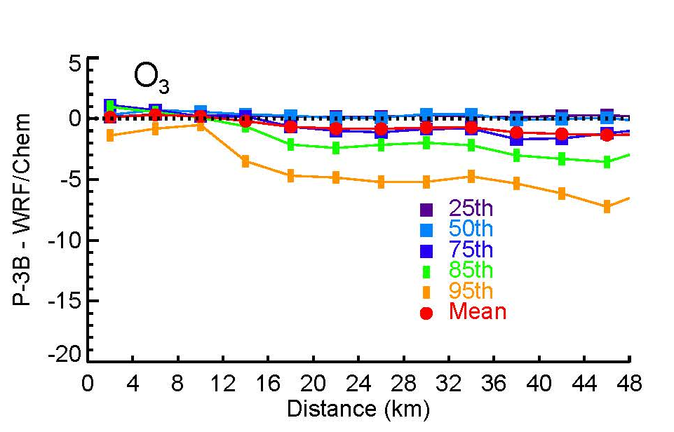
P-3B vs. WRF/Chem differences - Ozone
WRF/Chem output was sampled along the P-3B flight track
Difference percentiles
P-3B – WRF/Chem for each percentile
The WRF/Chem and P-3B variability compare reasonably well (within ~5 ppbv). Now let’s look at variability within WRF/Chem as it relates to a satellite like TEMPO
(Additional comparisons for NO2, CO, HCHO, Isoprene, and NO not shown)

Slide 6
TEMPO science questions
relevant to this work
What are the temporal and spatial variations of emissions of gases and aerosols important for AQ and climate?
How can observations from space improve AQ forecasts and assessments for societal benefit?
How much does each species vary spatially and temporally throughout the campaign? (i.e. one month)
How much of that variability would a TEMPO-like instrument see?
Is the resolvable variability sufficient answer the relevant science questions?

Slide 7
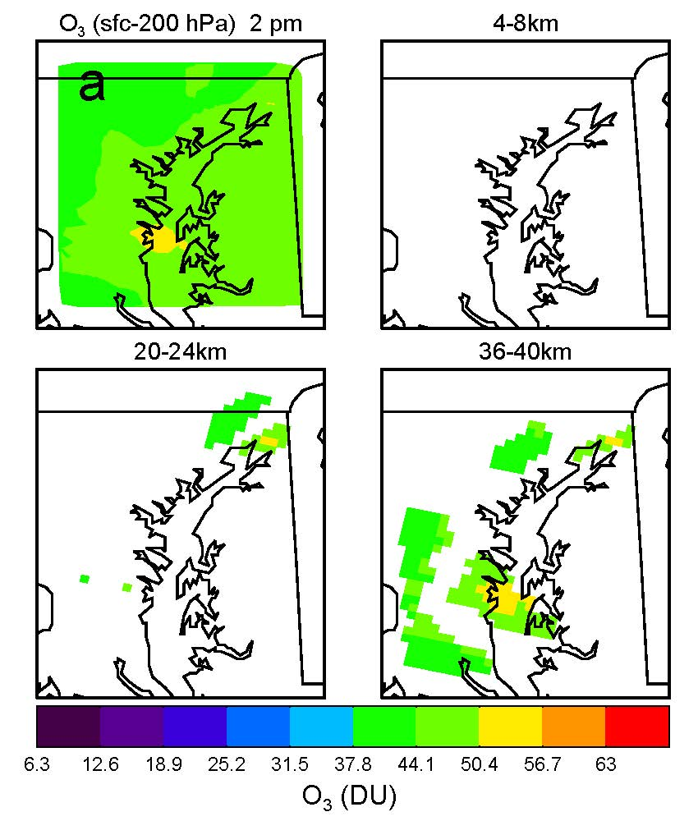
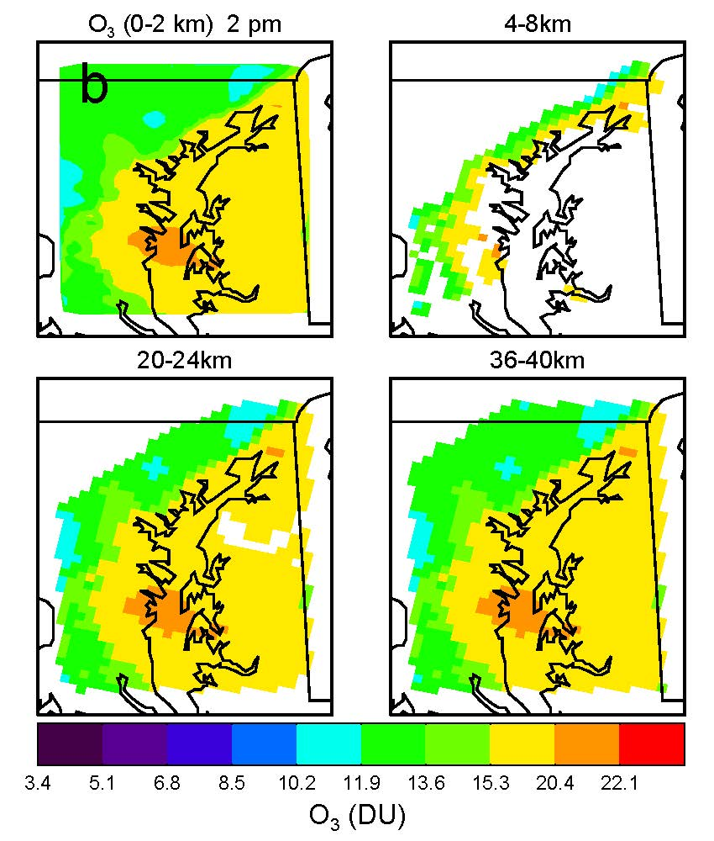
Geographic coverage of differences that fall above the PRs at several distances
Trop Column ozone has a relatively shallow field (42-54 DU)
Features appear when considering 36+km distances
Range of values is similar to tropospheric column O₃ (~10-22 DU), but the PR is lower
The entire field is almost visible at distances over 20 km
O₃ - Tropospheric column
O₃ - 0 – 2 km
These results indicate that the TEMPO instrument would be able to observe O₃ air quality events over the Mid-Atlantic area, even on days when the violations of the air quality standard are not widespread.
Precision requirement = 6.3 DU
Precision requirement = 1.7 DU
7/29/2011 2 pm EDT

Slide 8
Some highlights…
Follette-Cook et al. - manuscript in preparation for Atmos. Environ.
WRF/Chem reproduces the variability observed during the July 2011 DISCOVER-AQ campaign reasonably well
The TEMPO instrument should be able to observe Mid-Atlantic air quality events, especially in the 0-2 km altitude region
For trop. column NO₂, TEMPO should be able to observe not only the large urban plumes at times of peak production, but also the weaker gradients between rush hours.
More variability in HCHO seen at longer distances, i.e. greater than 20 km. Despite its short lifetime, trop. column HCHO is a regional-scale pollutant with both biogenic (e.g. isoprene) and anthropogenic sources (e.g. traffic and industrial emissions).
Overall, the results indicate that the PRs developed for TEMPO are sufficient for answering the air-quality relevant science questions they are tasked to address.

Slide 9
Evaluating NO₂ Variability from ACAM Column Measurements to Assess Urban Scale Variability Morgan Silverman SSAI/LaRC Poster 3094
Goal: Asses whether ACAM NO₂ vertical column density (VCD) measurements can represent surface NO₂ variability.
ACAM Vertical Column Density
Average Mixed Layer NO₂
Method:
Assume NO₂ VCD confined to mixed layer (ML) and well mixed
      Estimate surface NO₂ mixing ratio by normalizing ACAM NO₂ VCD with HSRL ML air number density. This constitutes the remotely-sensed estimate for ground level NO2.
NO₂ hot spots associated with major point and mobile sources (I-95/I-695 corridor and Baltimore Harbor shipping and industrial area)
Derived NO₂ surface mixing ratio resembles similar VCD spatial variability.

Slide 10
Evaluating NO₂ Derived from ACAM Column Measurements
Better agreement between surface NO₂ and derived ACAM mixing ratio than between surface and ACAM vertical column densities.
Discrepancy between derived ACAM mixing ratios and surface measurements are potentially due to spatial and vertical inhomogeneity (i.e. NO₂ above the ML).
Conclusion: Derived ACAM surface mixing ratios reflect the spatial variability of vertical column densities and show a strong influence of boundary layer depth on NO₂ values.
Notes:
First point is indicative of lack of dependence of NO2 column on surface concentrations.

Slide 11
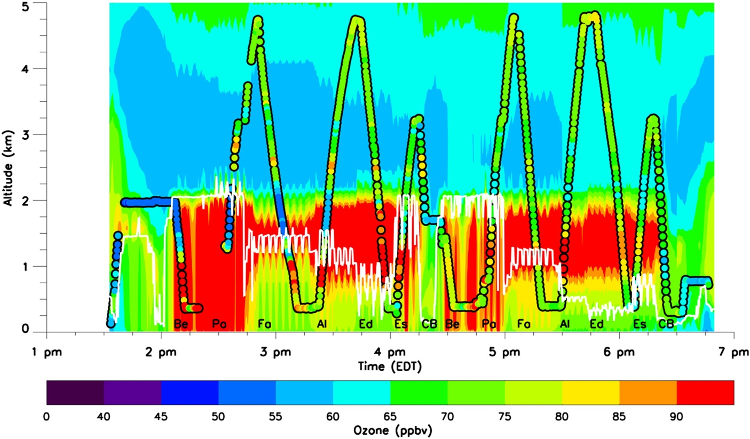
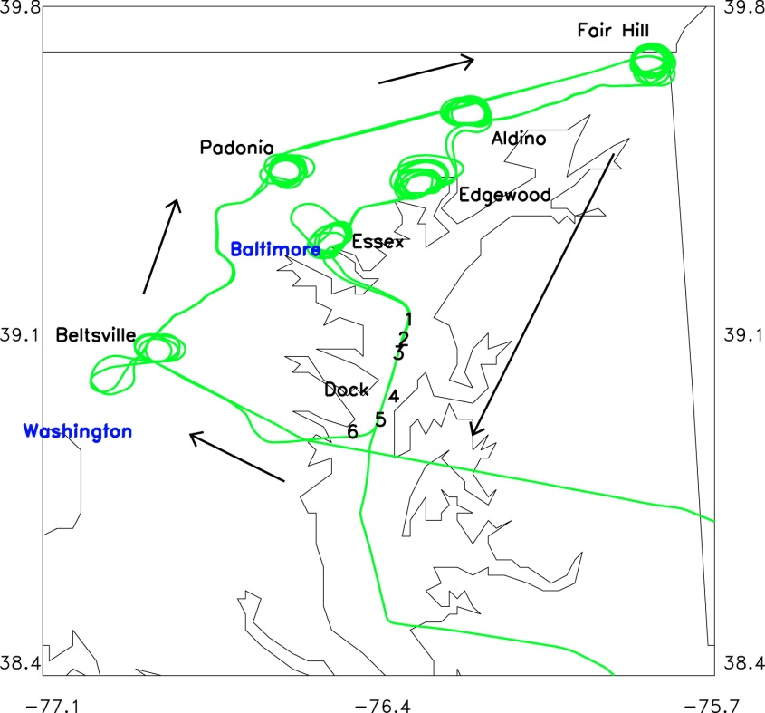
Sharp ozone gradient near bay breeze front – DISCOVER-AQ Maryland
Bay breeze convergence zone located in the urban corridor near Beltsville and Padonia. Sharp horizontal gradient with peak ozone located near bay breeze front.
11 July 2011 CMAQ simulated and P-3B observed ozone
P-3B flight track (green)

Slide 12
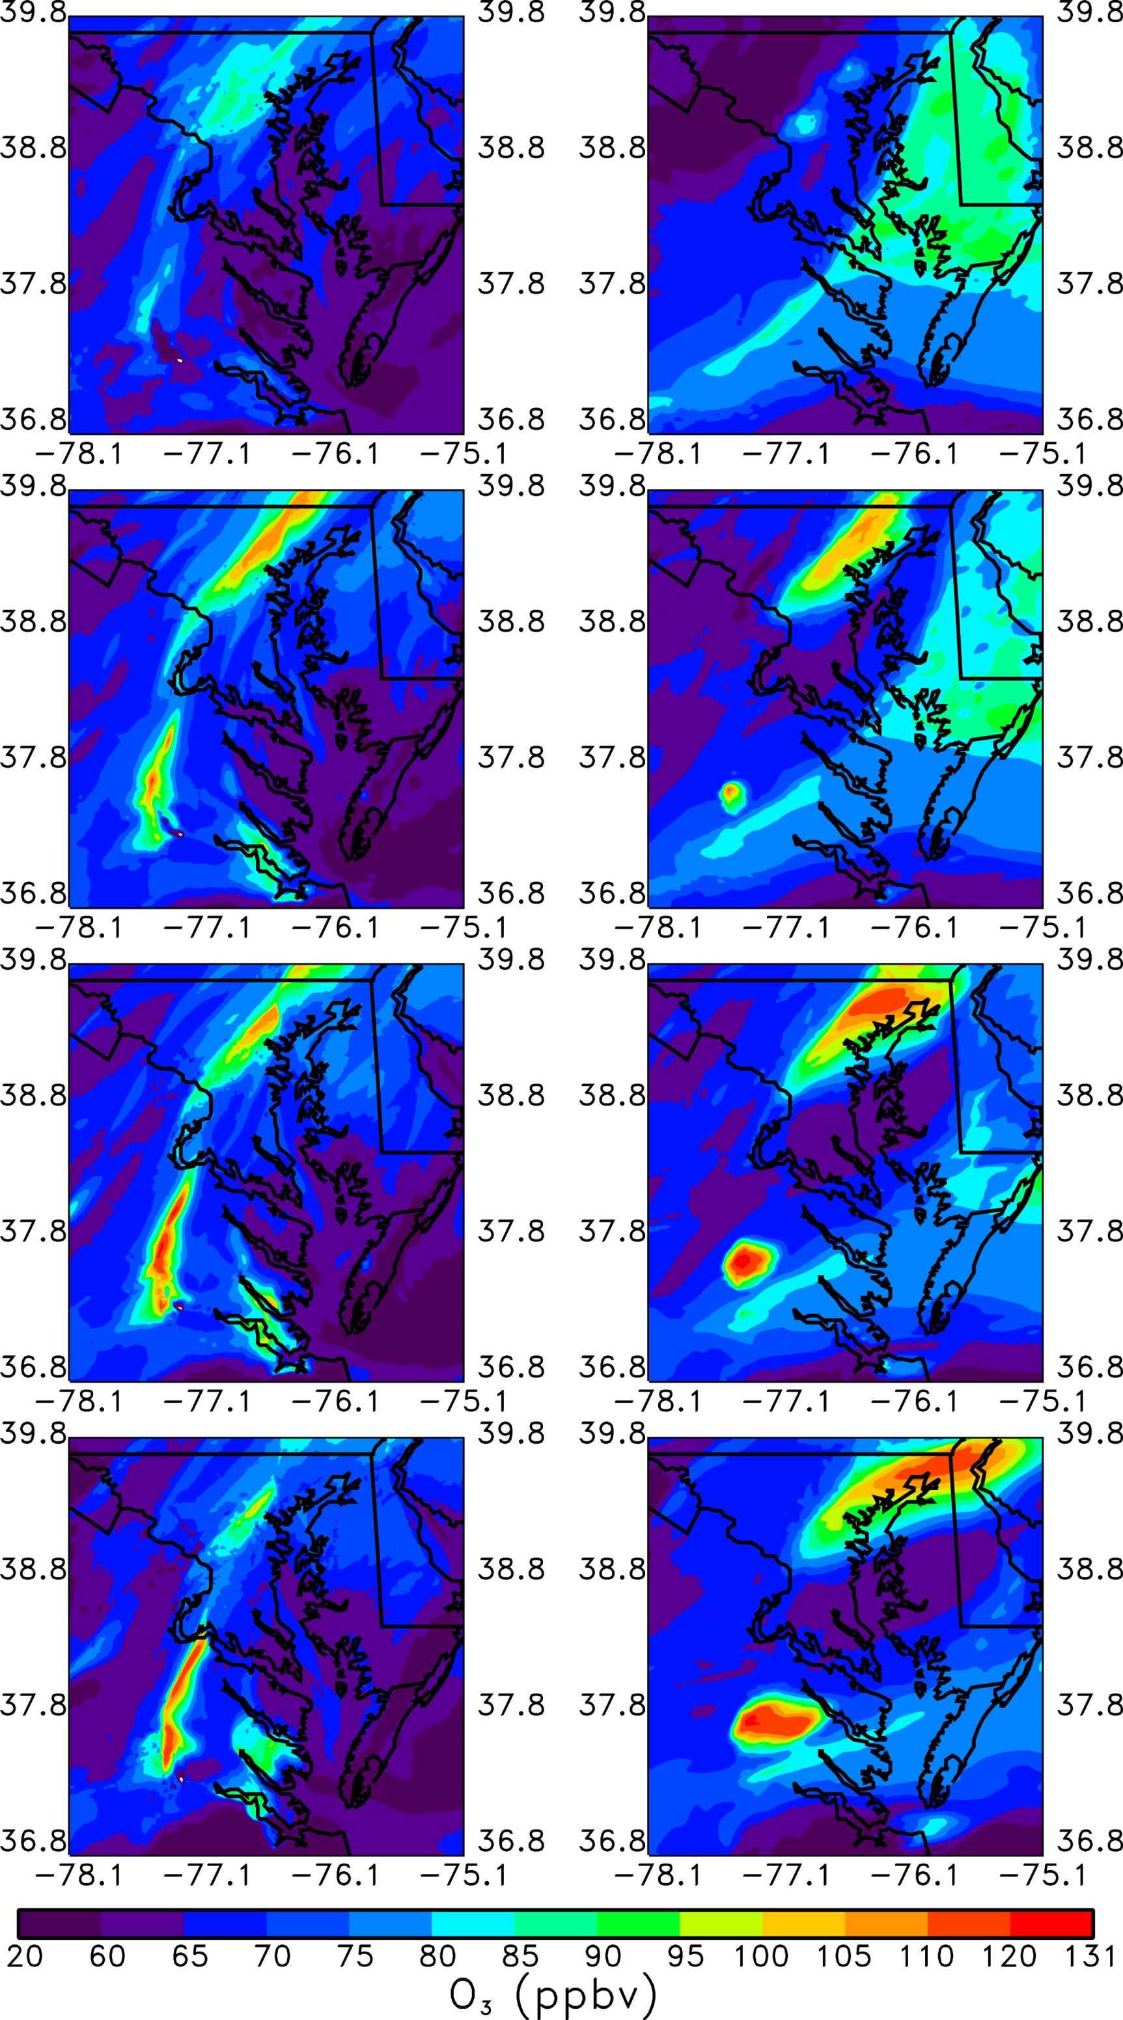

Sharp ozone gradient near bay breeze front – DISCOVER-AQ Maryland
Bay breeze convergence zone located in the urban corridor. Sharp horizontal gradient with peak ozone located near bay breeze front.
11 AM EST 11 July 2011
surface ozone
1 PM EST 11 July 2011
surface ozone
Bay breeze convergence zone

Slide 13
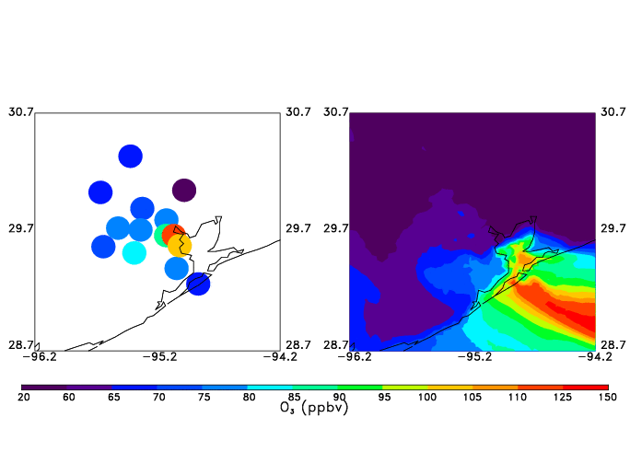
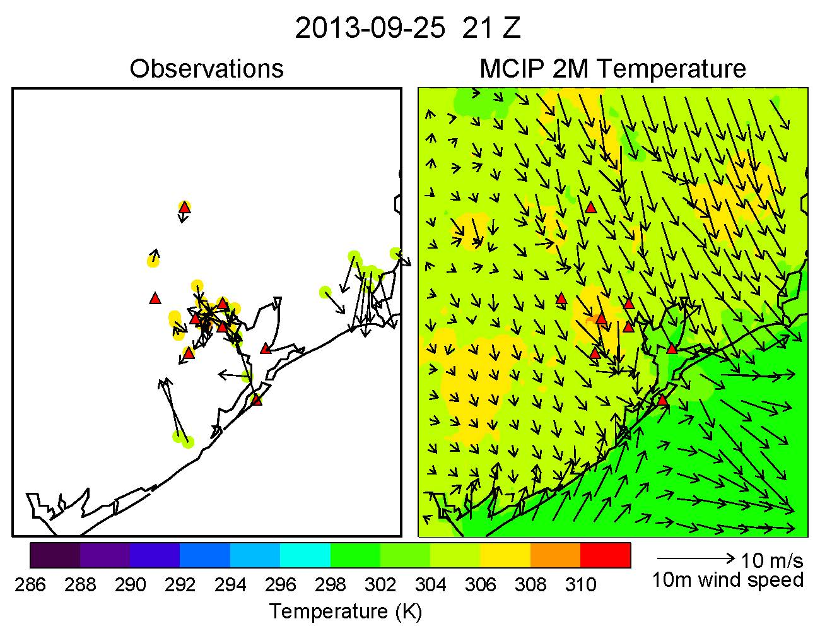
Sharp ozone gradient near bay breeze front – DISCOVER-AQ Houston
Peak maximum 8 hour average ozone located near bay breeze front.
3 PM CST 25 September 2013
observed 2 m temperature
and 10 m wind velocity
25 September 2013
observed maximum 8 hour average surface ozone
Bay breeze front

Slide 14
Clustering Algorithm Applied to Maryland July 2011 P-3B Profiles
Clare Flynn, UMD
Poster 3093, this AM
Cluster 1 (both O₃ and NO₂)
includes profiles from 5 sites;
trajectories from Ohio River
Valley
Cluster 4 (both O₃ and NO₂)
includes profiles from only
Essex and Edgewood; strong
flow from northern Canada, but
yet NO2 is largest → local
influence most important
Cluster 2 (lowest O₃) associated
with northerly flow from
Canada
Mean PBL height corresponds to slope change in mean NO₂ profile shapes, but not for O₃
Temperature lapse Mrate relationship to vertical mixing appears stronger for O₃ than NO₂
Local emissions appear more important for NO₂ profile shape than air mass origin

Slide 15
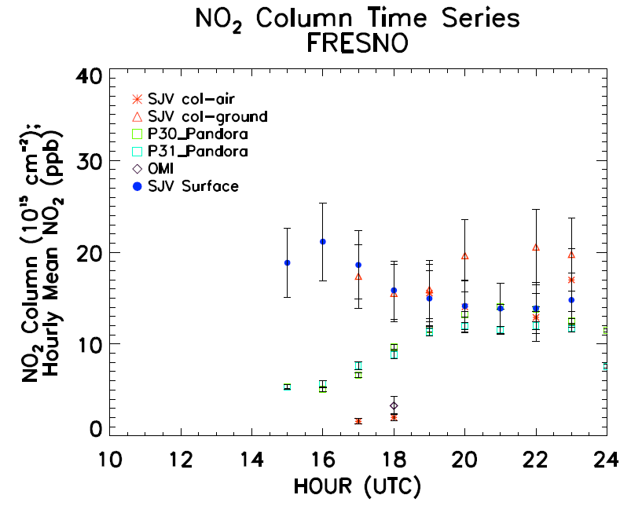
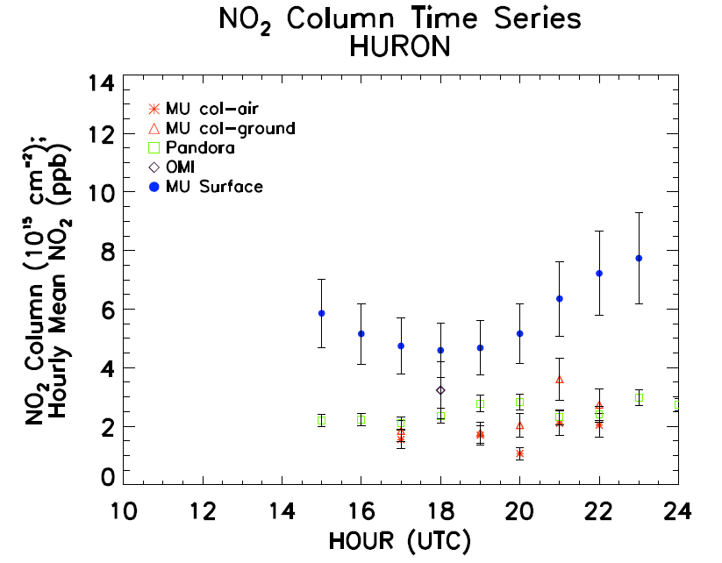
Temporal Variability in Column vs. Surface Observations
Clare Flynn, UMD
FRESNO:
With very shallow early AM PBL, Pandora
column is small despite peak surface NO₂
As PBL grows through the morning, Pandora
column increases, as surface NO₂ declines due
to vertical mixing
HURON:
Much smaller surface NO₂ than Fresno;
Very little change in Pandora column
Demonstrates need to consider PBL
height when using column NO₂ to
estimate surface mixing ratios

Slide 16
Summary
Spatial and temporal variability in the Maryland DISCOVER-AQ campaign was used to show that TEMPO will be capable of mapping evolution of ozone pollution episodes and map NO₂ urban plumes even outside rush hour periods.
ACAM NO₂ columns were shown to represent surface NO₂ variability when PBL depth is considered.
Coastal circulations add substantially to spatial variability of trace gases
P-3B profiles can be clustered to illustrate controlling factors on profile shape, which is an important aspect in satellite retrievals.
Posters: Flynn 3093; Silverman 3094; Morris 3095
This session: All talks use DISCOVER-AQ data to characterize variability!
Hope you can stay for the entire session!

