Slide 1
INSPYRE Data Repository and Requirements
Michael Shook
NASA Langley Research Center

Slide 2
INSPYRE Data Policy
All participants are requested to accept the following responsibilities:
Submit data!
  Follow data deadlines, format requirements, and best practices (described in the OSDMP)
  Publication-quality or “final” data must be submitted to the data repository prior to any public presentation at scientific conferences (e.g., AGU, AMS) or manuscript submission
Be a responsible data user
  Consult data PIs and any documentation when using data for presentations/manuscripts
  Offer coauthorship
Be a responsible data provider
  Be available to answer questions about your data
  Provide sufficient documentation (readme files, etc.)
  Ask questions and provide constructive feedback about data submission/best practices

Slide 3
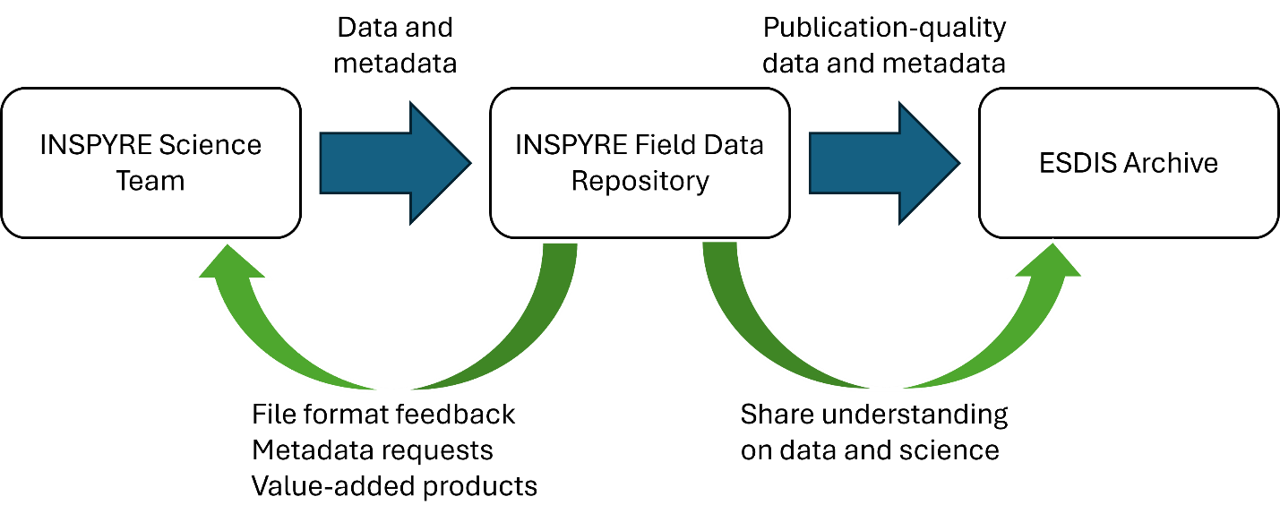
INSPYRE Data Repository and Requirements
Field Data Repository
www-air.larc.nasa.gov
Data Management Team
  Michael Shook, Gao Chen, Morgan Silverman
Primarily serving the science team and interfacing with ESDIS
Submit data here!
ESDIS Archive
earthdata.nasa.gov
Suborbital Archive Readiness (SoAR)
  Geoffrey Stano, Stephanie Wingo
Permanent archive and public distribution for publication-quality data
Cite data here!

Slide 4
INSPYRE Data Repository and Requirements
Two Phase Data Submission Process:
1) Submit field data within 24 hours of flight or data collection to Field Data Repository (www-air)
  Minimal QA/QC, used as “proof of life” and to help plan future data collection
  Files will remain password protected and only accessible by the science team and approved partners

Slide 5
INSPYRE Data Repository and Requirements
Two Phase Data Submission Process:
2) Submit publication-quality (sometimes called “final”) data within 6 months of deployment completion to Field Data Repository (www-air)
  Full QA/QC, all calibrations applied, etc.
  These files will be transferred to the ESDIS Archive for public distribution (may take a few weeks to assemble metadata records, generate DOIs, etc.)

Slide 6
INSPYRE Data Repository and Requirements
Deployment Period | Field Data to Field Data Repository | Publication-Quality Data to Field Data Repository | Publication-Quality Data Transfer to ESDIS
July-September 2026 | 24 hours after flight or data collection | March 15, 2027 | June 30, 2027
July-September 2027 | 24 hours after flight or data collection | March 15, 2028 | June 30, 2028

Slide 7
INSPYRE Data Repository and Requirements
Exceptions to the nominal submission process:
NASA Facility Instruments (e.g., MASTER)
Modeling teams
Some no-cost data providers

Slide 8
OSDMP Summary – SPD-41a
NASA Science Mission Directorate data policy is governed by SPD-41a (Scientific Information Policy for the Science Mission Directorate)
Spirit of the law: NASA does “Open Science”
  Data collection is taxpayer-funded, so the data should be available to the public
  No exclusive access/embargo period: data must be publicly available prior to publication submission or public presentation
Data should be released as Creative Commons Zero (no requirements/restrictions on use)
All peer-reviewed publications must be publicly accessible, either in open access journal or by submitting the publication to PubSpace (https://sti.nasa.gov/submit-to-pubspace)
Includes some software

Slide 9
OSDMP Summary – Open Software
“Any scientifically relevant code (code that is critical for the derivation of disseminated science findings) … will be delivered to a publicly accessible repository supportive of community and developer reuse”
github.com/nasa (or your institutional repository), Zenodo/figshare, supplement, etc.
Does not include software developed only for preliminary analysis, plans for future research, or communication with colleagues
Does not include software developed as part of previous work (if not enhanced for INSPYRE)
Does not require or imply ongoing support/maintenance of the code once shared
“Science software used to create the publication-quality data products will be provided to ESDIS at the end of the investigation with the final products”
Zipped with Level 0 or raw data
Preservation activity to ensure data could be reproduced if necessary at a later date
Not expected to be publicly accessible

Slide 10
OSDMP Summary – FAIR Principles
Findable
Datasets on ESDIS Archive have DOIs
Standards for collection and variable-level metadata (GCMD keywords, ACVSNC standard names)
Accessible
Publicly available via ESDIS Archive
Merge tool for in-situ data

Slide 11
OSDMP Summary – FAIR Principles
Interoperable
File format requirements, scanners for ICARTT and netCDF/HDF files
Data reporting requirements
  Time synchronization and reporting
  STP, dN/dlogDp for aerosol
  Dry molar fractions or ambient volumetric mixing ratio for gases
  Standard variable name metadata and unit notation
(Re)usable
Readme files, ATBDs, other documentation
Include sufficient metadata, e.g. long_name, units

Slide 12
Points of Contact
INSPYRE Field Data Repository (www-air.larc.nasa.gov):
Michael Shook (michael.shook@nasa.gov, 757-864-5793)
Gao Chen (gao.chen@nasa.gov, 757-864-2290)
Morgan Silverman (morgan.l.silverman@nasa.gov, standard variable names)
INSPYRE ESDIS Archive/SoAR Team:
Geoffrey Stano (gts0007@uah.edu)
Stephanie Wingo (stephanie.m.wingo@nasa.gov)
SoAR Team (soar@lists.nasa.gov)

