Slide 1
KORUS-AQ Assets
These slides outline the major Korean and US assets available for May – June 2016 Field Campaign focused on the Korean Peninsula and surrounding waters.
Barry Lefer, Jeong-Hoo Park, Gangwoong Lee, and Joe Salisbury

Slide 2
Funding was applied primarily to instrument the DC-8 Aircraft with limited funds for additional ground measurements and modeling support.

Slide 3
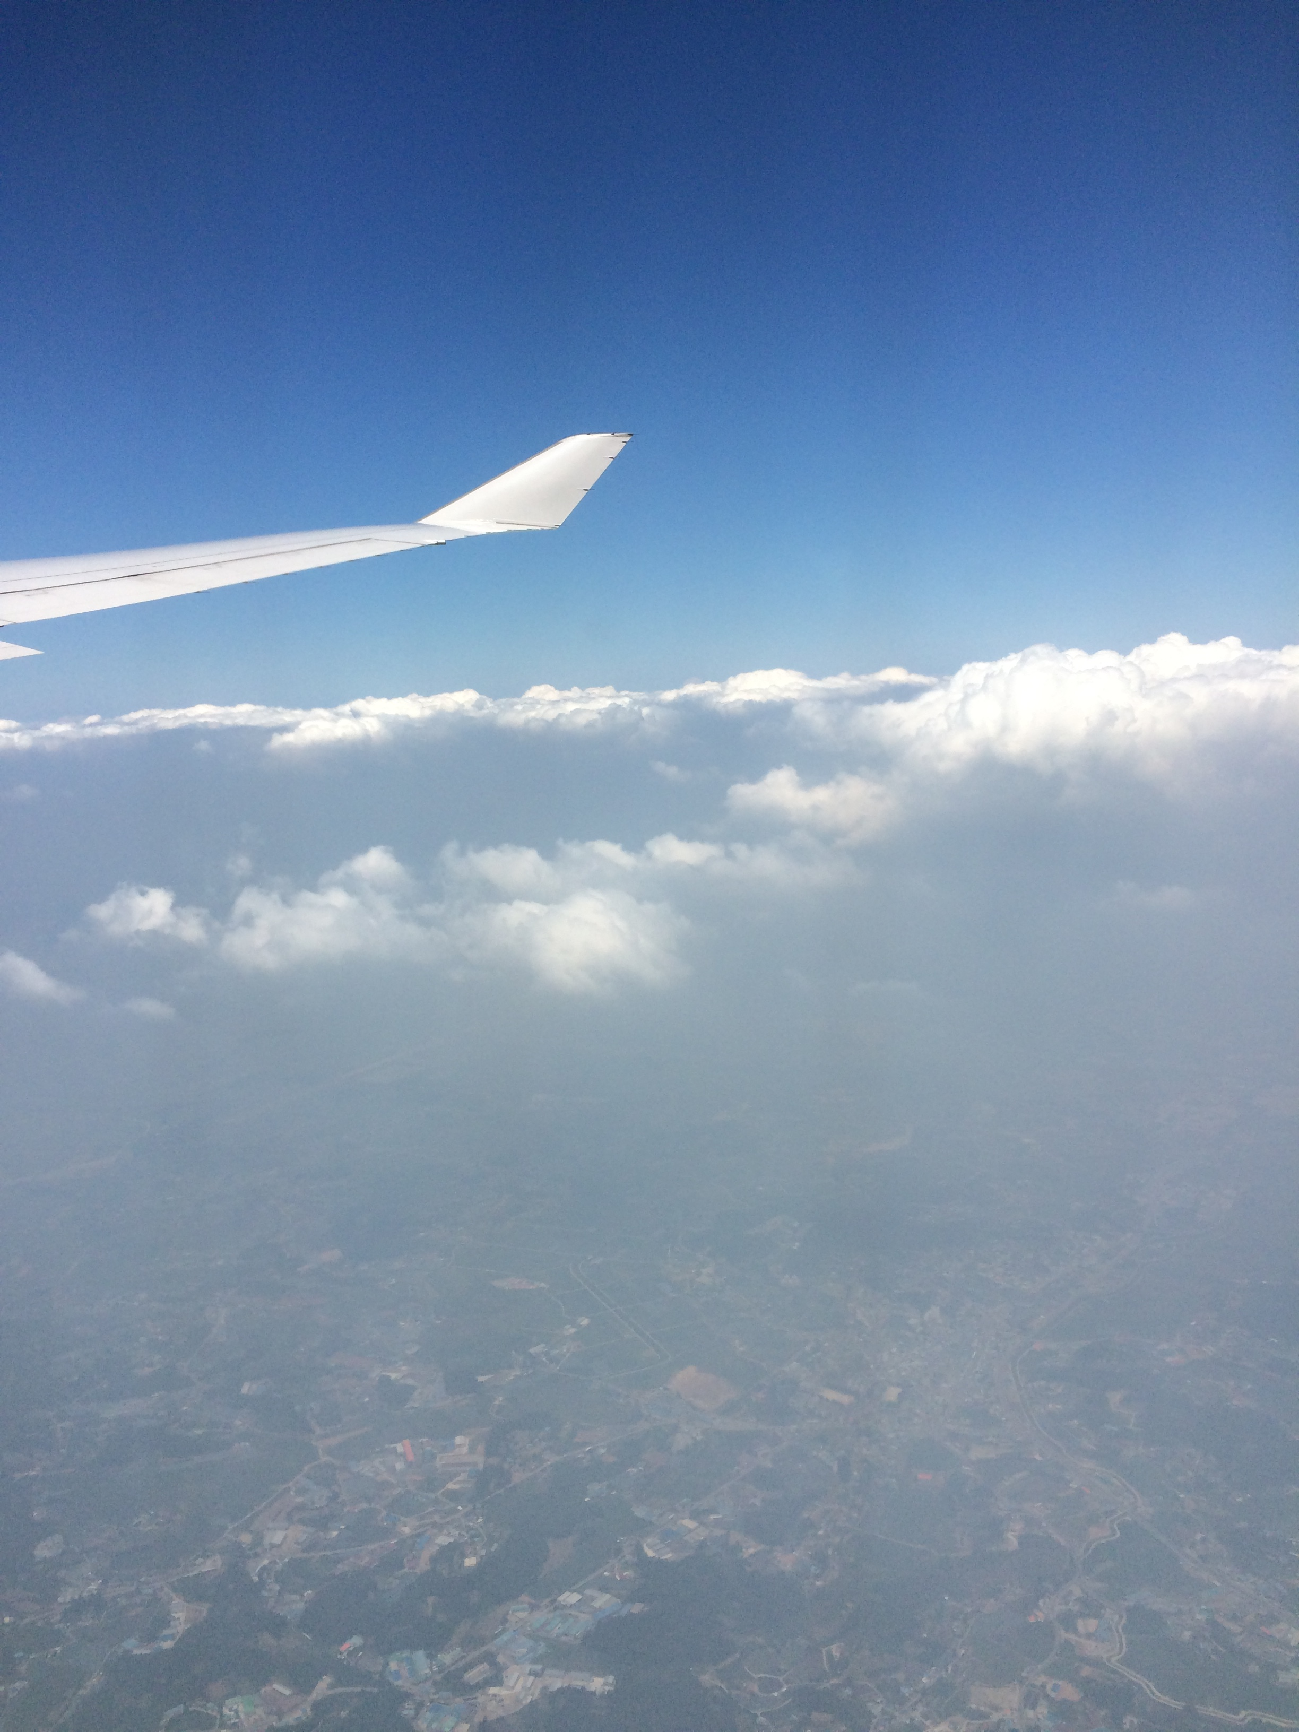
Overview of KORUS-AQ Assets
Aircraft
NASA DC-8
NASA King Air
Hanseo Univ. King Air
KMA King Air
Ship
KIOST R/V Onnuri
KMA R/V Kisang I
Ground
MoE National Network
Research Sites (Univ., NIER, KMA)
CIMEL/Pandora
Model Forecast Support

Slide 4
KORUS-AQ DC-8 Measurement PI Team (Part 1 of 3)
Ahn, Joon-Young (NIER) | Airborne Measurements of Black Carbon Mass during KORUS-AQ
Anderson, Bruce (LaRC) | AN AIRBORNE INVESTIGATION OF AEROSOL AND CLOUD PROPERTIES IN SUPPORT OF KORUS-AQ
Blake, Don (UC-Irvine) | Whole Air Sampling (WAS) From the NASA DC-8 Aircraft During the KORUS-AQ Field Campaign
Brune, Bill (Penn State) | KORUS-AQ oxidation chemistry: DC-8 measurements of OH, HO2, and OH reactivity
Cohen, Ron (Berkeley) | Nitrogen oxide chemistry over the Korean peninsula: Comparing in situ observations with remote sensing
Dibb, Jack (UNH) | UNH SAGA contribution to DC-8 payload for KORUS AQ
Diskin, Glenn (LaRC) | Airborne Measurements and Analysis of H2O(v), CO, CH4, and N2O in support of the KORUS-AQ Field Campaign
Fried, Alan (Univ CO) | Fast Airborne Measurements of Formaldehyde and Ethane on NASA's DC-8 Employing an Infrared Absorption Spectrometer During the KORUS-AQ Study

Slide 5
KORUS-AQ DC-8 Measurement PI Team (Part 2 of 3)
Hair, John (LaRC) | Airborne Lidar Investigations of Ozone, Aerosol, and Clouds as Part of KORUS on the NASA DC-8
Hall, Sam (NCAR) | Airborne actinic flux measurements and photolysis frequencies in support of KORUS-AQ science
Hanisco, Tom (GSFC)* | In Situ Airborne Formaldehyde (ISAF) measurements for KORUS
Huey, Greg (GIT) | Collaborative Ground and Airborne Observations of Reactive Nitrogen, Halogens, and SO2 during the KORUS-AQ campaign
Janz, Scott (GSFC)** | GeoTASO Measurements of Aerosols and Tropospheric NO2, O3, CH2O, and SO2 Vertical Column Density (VCD) in support of KORUS-AQ
Min, Kyung-Eun (GIST) | Airborne measurements of HONO and NO2 using Cavity Enhanced Absorption Spectroscopy.
Lee, Sang-Deog (NIER) | Airborne Observations of Reactive Nitrogen and SO2 during the KORUS-AQ campaign
Jimenez, Jose (Univ CO) | Aerosol Mass Spectrometer Measurements on the DC8 during KORUS-AQ to Study Secondary Aerosol Sources, Formation and Aging
Park, Jeong-Hoo (NIER) | Airborne PTR-ToF-MS measurements of NMHCs on the DC-8 during KORUS-AQ

Slide 6
KORUS-AQ DC-8 Measurement PI Team (Part 3 of 3)
Park, Jinsoo (NIER) | Aerosol Mass Spectrometer Measurements on the DC-8 during KORUS-AQ
Redemann, Jens (ARC) | Airborne measurements of multi-spectral optical depth and retrievals of trace gas column contents and aerosol properties from 4STAR during KORUS-AQ
Schwarz, Joshua (NOAA) | Measurements of Black Carbon Mass and Mixing State, and the Hygroscopicity of Internally Mixed Materials During KORUS-AQ
Weinheimer, Andy (NCAR) | Measurements of NO, NO2, NOy, and O3 from the DC-8 During KORUS-AQ
Wennberg, Paul (CIT) | Peroxides, Acids, and Organic Oxygenates for KORUS
Wisthaler, Armin (Innsbruck) | PTR-ToF-MS measurements of NMHCs in support of KORUS-AQ
Yang, Melissa (LaRC)*** | DC-8-based Observations of Atmospheric CO2 in Support of the KORUS-AQ Regional Studies
Yum, Seong Soo (Yonsei Univ) | Airborne measurements of CCN on the DC-8 during KORUS-AQ

Slide 7
KORUS-AQ Ground Measurement PI Team
Eloranta, Edwin (Wisc) | HSRL DEPLOYMENT TO SEOUL, SOUTH KOREA
Herman, Jay (UMBC) | PANDORA Deployment to South Korea for KORUS-AQ
Holdben, Brent (GSFC) | Enhanced AERONET Network in South Korea for KORUS-AQ
Thomas McGee (GSFC) | KORUS-AQ Ozone LIDAR Measurements
Thompson, Anne (GSFC) | KORUS-AQ Ozonesonde Measurements
Korean Air Quality Measurement Sites

Slide 8
KORUS-AQ Forecasting PI Team
Carmichael, Gregory (Iowa) | Regional Scale Modeling in Support of KORUS-AQ: Improving Predictions of Dynamic Air Quality Using Aircraft, Ground Networks, and Satellite Data
Emmons, Louisa (NCAR) | Global and Regional Chemical Forecasting and Analysis using CAM-chem, Data Assimilation and WRF-Chem for KORUS-AQ
da Silva, Arlindo (GSFC) | GEOS-5 Chemical and Meteorological Forecasting Support for the KORUS-AQ Campaign
Hyer, Edward (NRL) | Advanced geostationary and lidar satellite data exploitation in support of KORUS-AQ mission planning and forecasting
Korean Air Quality and Meteorological Modeling Teams

Slide 9
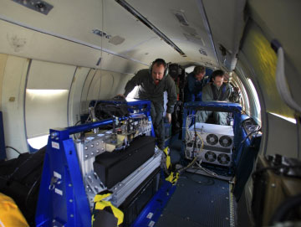
KORUS-AQ King Air (LaRC)
GeoTASO (TEMPO/GEMS Airborne Simulator) Geostationary Trace gas and Aerosol Sensor Optimization
NASA-funded airborne sensor and trace gas/aerosol retrieval project to advance mission readiness of sensor/algorithms for GEO-CAPE/TEMPO missions
UV-Vis spectrometer with 2 2-D detector arrays covering 290-390 nm (O₃, SO₂, HCHO) and 415-695 nm (NO₂, O₃, aerosol)
Imaging spectrometer covers ~8 km swath with 50 m x 80 m ground patch resolution
Spectral passbands of ~ 0.4 nm in UV, ~0.8 nm in Vis with 3x oversampling spectrally
Signal to noise of ~ 50 for individual samples

Slide 10
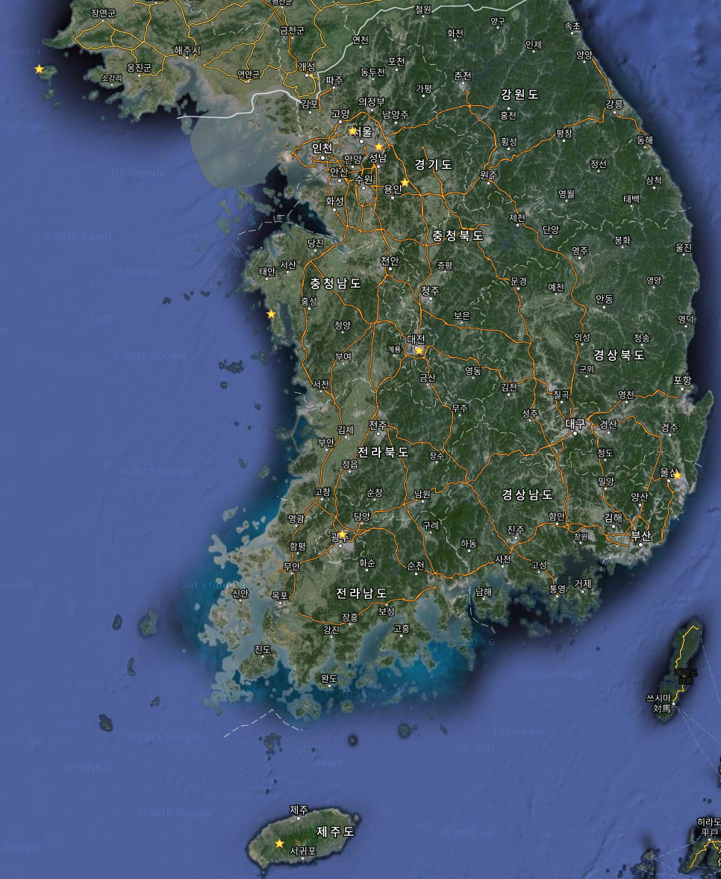
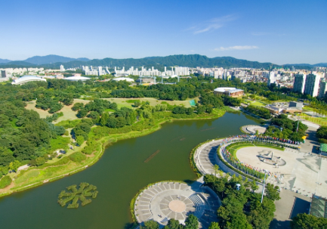
2016 Korus-AQ ground observation sites.
Baeognyeong
Seoul
Mt. Taehwa
Olympic Park
Gwangju
Daejeon
Jeju
Ulsan

Slide 11
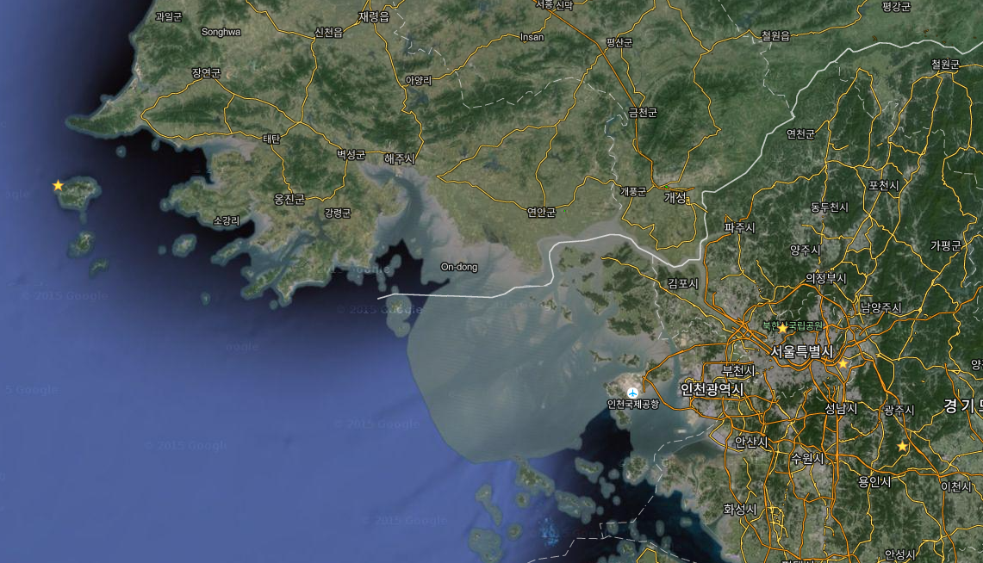
3 Main Upwind, Urban and Downwind ground observation sites.
Baeognyeong
Olympic Park
Mt. Taehwa

Slide 12
Measurement species
Species | BNI | Olympic Park | Taewha | Seoul | Jeju | Daejeon | Gwangju | Ulsan
NO, NO2 | ◎ | ◎ | ◎ | ◎ | ◎
O3 | ◎ | ◎ | ◎ | ◎ | ◎
SO2 | ◎ | ◎ | ◎ | ◎ | ◎
CO | ◎ | ◎ | ◎ | ◎ | ◎ | ◎ | ◎ | ◎
NH3 | ◎ | ◎ | ◎
HNO2, HNO3 | ◎ | ◎ | ◎
NMHCs | ◎ | ◎ | ◎ | ◎
BVOCs |  | ◎ | ◎
OH Radical |  | ◎ | ◎
PAN | ◎ | ◎ | ◎ | ◎
HCHO and Aldehyde | ◎ | ◎ | ◎
HONO, H2O2 |  | ◎
PM2.5 Mass & Composition | ◎ | ◎ | ◎ | ◎ | ◎ | ◎ | ◎ | ◎
OC/EC | ◎ | ◎ | ◎ | ◎ | ◎ | ◎ | ◎ | ◎
Black Carbon | ◎ | ◎ | ◎ | ◎ | ◎ | ◎ | ◎ | ◎
refractory Black Carbon | ◎ | ◎ |  | ◎
Water soluble organic aerosol | ◎ | ◎ | ◎
High resolution aerosol speciation | ◎ | ◎ | ◎ | ◎

Slide 13
Aircraft observation
Measurement Species
- HCHO (from NASA)
- CH₄, CO₂
- O₃, SO₂
- NO₂
- CPC
Hanseo King-Air
General Aircraft Speciations
- Max. speed 270kt(500km/h)
- Certified Ceiling 30,000ft
- Max. Range 1,311nm(2,428km)
- Payload 7,235lb(350kg)
- E. Power 220V, 30A
King-Air C90GTx
KMA King-Air
King-Air 350HW

Slide 14
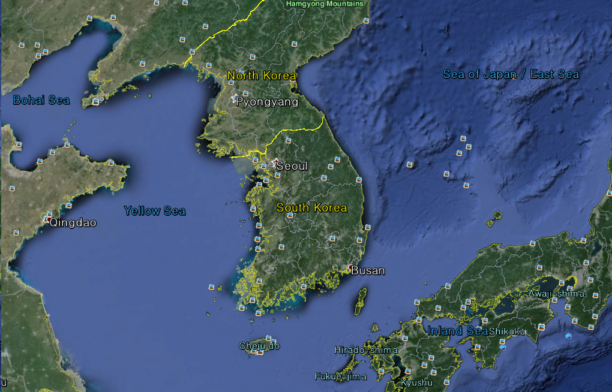
Aircraft observation by King Air 350HW
Instruments for meteorological elements
Drop sonde, Watching camera(RSX-3), Aviation radar(TWR-850), Microwave radiometer
Cloud & Precipitation
Cloud particle number distribution(Hawkeye)
Precipitation particle number distribution(High Volume Precipitation Spectrometer)
Aerosol
Nuclei particles(CCN-200)
Particle size distribution(Sky-OPC)
Scattering coeffcient(Nephelometer)
BC(Single Particle Soot Photometer)
Gases
Pollutants(NOx, SO₂, CO, O₃)(Analyzer)
GHGs(CO₂, CH₄, H₂0)(CRDS)
Flight Plan

Slide 15
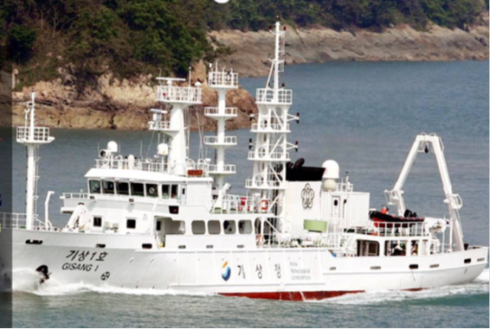
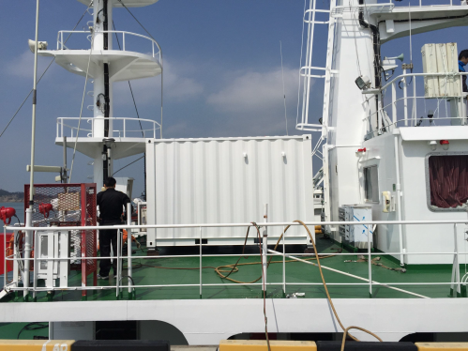
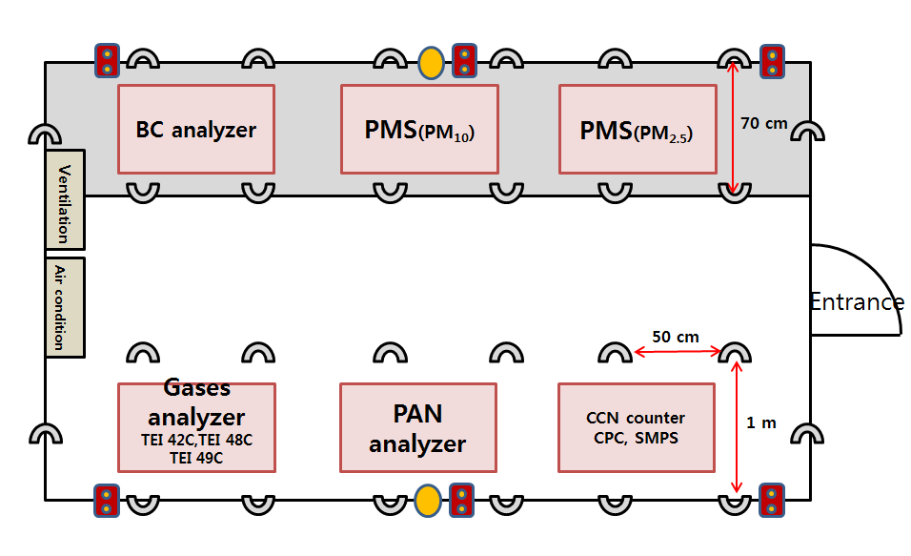
Vessel observation by Kisang 1st
Instruments for meteorological elements
AWS, radio sonde
Cooperating Observations
- Yonsei Univ: Aerosol Observation(CCN Counter, CPC, SMPS)
- Korea Univ: Gases Observation(PAN, CO, NOx, O₃)(Analyzer)
- NIMS: PMS (PM10, PM2.5) for aerosol mass and chemical components
PM10 mass concentration (PM10 beta-ray)
Holes for Inlet : 6
Available Installing Rack : 1
Outdoor observation also available.
Voyage plan of Vessel

Slide 16
Ground observation by 3 sites
at Seoul
- Aerosol: PM10 mass concentration(PM10 beta-ray)
Size distribution(APS,OPC(0.3~20μm))
Chemical components(IC)
at Anmyon
- Aerosol: PM10 mass concentration(PM10 beta-ray)
Size distribution (APS,OPC(0.3~20μm))
Chemical components(IC)
Vertical aerosol extinction coefficient profile(LIDAR)
Scattering and absorption (Nephelometer, Aethalometer)
- Gases: Pollutants (NOx, SO₂, CO, O₃ )(Analyzer)
GHGs(CO₂, CH₄, H₂O, N₂O)(CRDS, GC)
at Jeju Gosan
- Aerosol: PM10 mass concentration(PM10 beta-ray)
Size distribution (APS,OPC(0.3~20μm))
Condensation Particle Counter (CPC)
- Gases: Pollutants (NOx, SO₂, CO, O₃ )(Analyzer)
GHGs(CO₂, CH₄, H₂O, N₂O)(CRDS, GC)
Anmyon
Seoul
Gosan
Meteorological elements at 3 sites are also observed.

Slide 17
Remote sensing
Pandora (O₃, NO₂, H₂O, SO₂, HCHO), AERONET(AOD)
LIDAR : Vertical profile of aerosol.

Slide 18
Risk reduction measurements for GEO-CAPE:
A US-Korea joint field campaign (KORUS-WQ) in the East Sea and Yellow Sea
US Steering Group: GEO-CAPE Ocean Color Science Working Group (ZP Lee first author of Whitepaper)
Korean Steering Group: Youngje Park, Yu-Hwan Ahn
Goal of GEO-CAPE this field campaign:
Address the impact of short-term processes on longer and large scale biogeochemical dynamics
Obtain unique data for risk reduction analyses for GEO-CAPE

Slide 19
Justification/ Logic:
Processes/ Features: eddy fields, bloom dynamics, CDOM production and removal, big tides, dynamic particle features
Leverages financial support by the GOCI team for ship time, logistics and satellite data resources
GOCI is the only ocean color sensor in geosynchronous orbit
Atmospheric correction opportunities
KORUS-AQ Synergy: Plus legwork, infrastructure, interdisciplinary opportunities

Slide 20
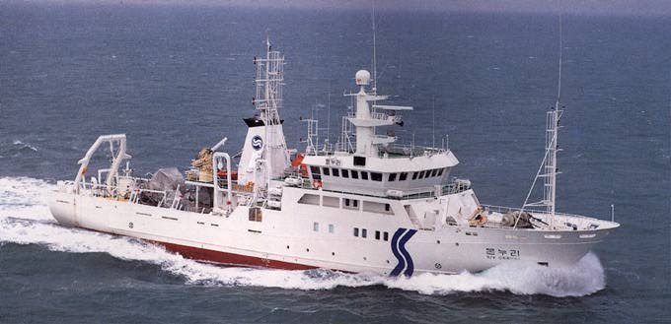
RV Onnuri (presently 17 DAS)
Notes:
Length (M): 63.80 Range (n. mi.): 10000 Crew: 7
Beam (M): 12.00 Endurance (days): 40 Officers: 8
Draft (M): 5.15 Cruise speed (kt): 15.0 Scientists: 25
Gross Tons: 1370 Max. speed (kt): 15.8 Air Cond.: yes
Power (HP): 3100 Aux. Power (HP): 1265
Main vessel activity
Oceanography Fisheries Geology Hydrography
Year built: 92
Ocean area where vessel operates: Pacific Ocean
Capacities and working spaces
Dry cargo holds: 0m3
Fuel: 358m3
Fresh water: 108m3
Wet laboratories (total area): 35m2
Dry laboratories (total area): 70m2
Fresh water generator capacity: 10m3
Freeboard to working deck: 2.9m
Free working deck area: 250m2
Space for container laboratory: 3m x 6m
Design Particulars
Hull materials: Steel
Energy sources
Main engine(s): number: 2 make: Diesel model:
Power (BHP) each main engine: 3100 at 900rpm
Diameter and max. rpm propeller: 3.300m 178rpm
Total power auxiliary diesels: 1265HP
Electrical systems
AC Voltage: 0/ 440V, total 1300kVA, 3phase, 60Hz
AC Voltage: 0/ 220V, total 0kVA, 0phase, 0Hz
DC Voltage: 0V, total 0V
Stabilized system for scientific equipment: 115VAC 150AMP 60Hz
Fixed equipment
Navigation and communication
Nav. equip: Radar SatNav Gyro DopLog
Comms: Fax SatCom
Comm sat:
GPS:
Acoustic
Echosounders for scientific research: 12kHz 38kHz
Sonar: Fisheries Sector-sca
Provisions for silent ship operation:
Oceanographic
Oceanographic winches: number: 0
Steel wire length: 9999m, safe working load: 10tons
Conducting cable length: 6000m, safe working load: 2tons
Trawl winch length: 0m, safe working load: 0tons
Other, specify:
length: 6000m, safe working load: 2tons
Gantry
Position: Stern, Midships
Clearance above deck: 7m and outboard extension: 3m
Safe working load at max. reach: 8tons
Crane
Position: Midships
Clearance above deck: 0m and outboard extension: 10m
Safe working load at max. reach: 1tons
Other winches for instruments or sampling:
Electronic data processing equipment permanently available on board
Computer: HEWLETT PACKARD HP 425S: :
Vessel construction and maintenance supervision
Construction supervised by:
Classification Society: KOREAN REGISTER
Others, specify:
Published vessel data
Magazine: R/V Onnuri (See Boxfile)

Slide 21
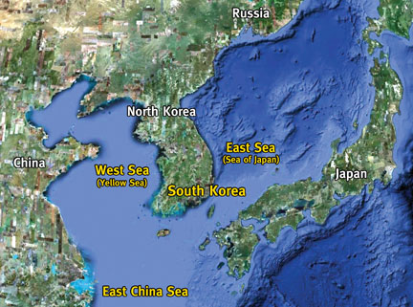
Where? Not entirely sure yet. Need to plan over-flights soon

Slide 22
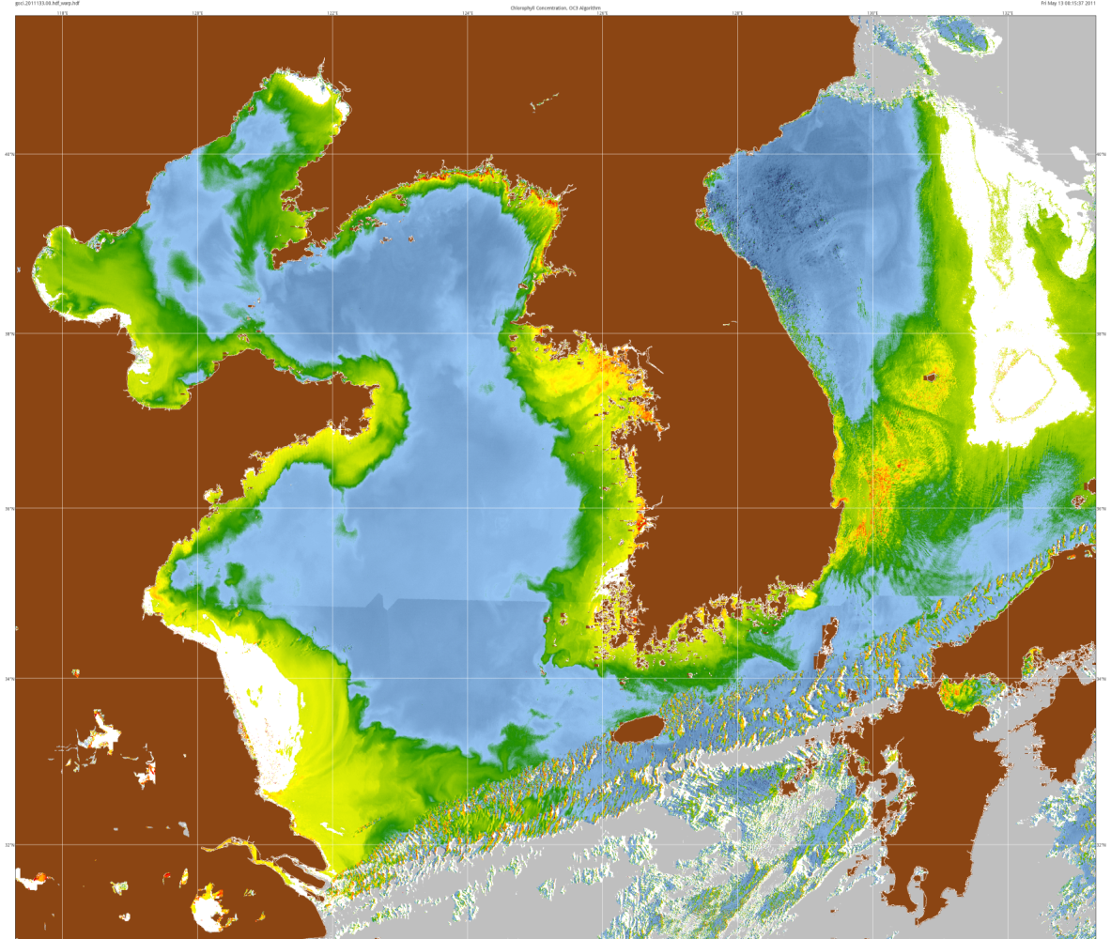
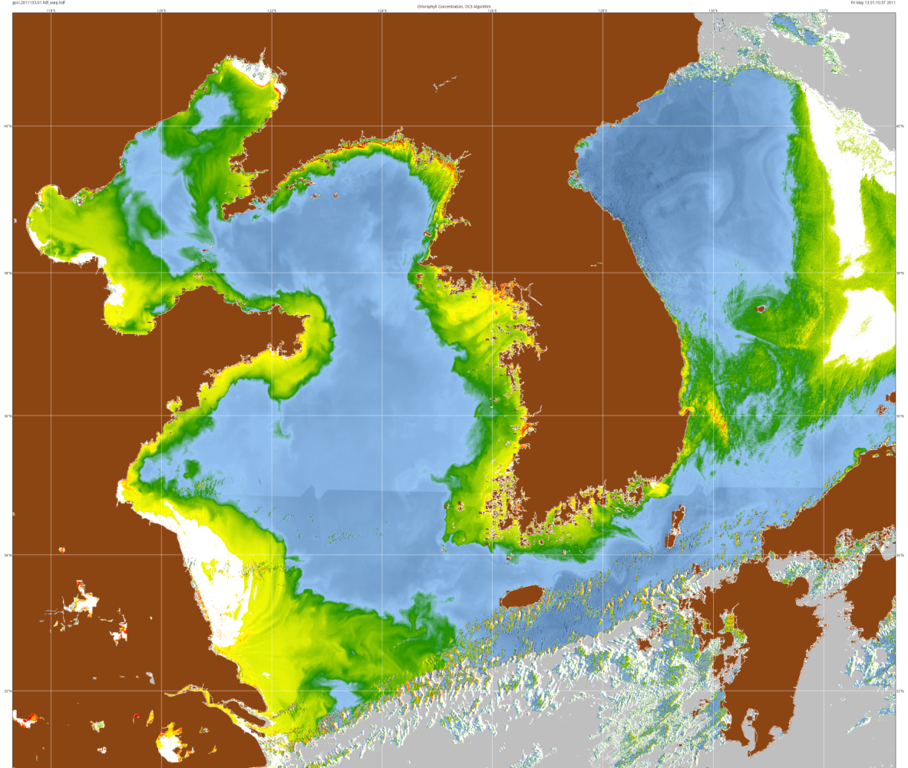
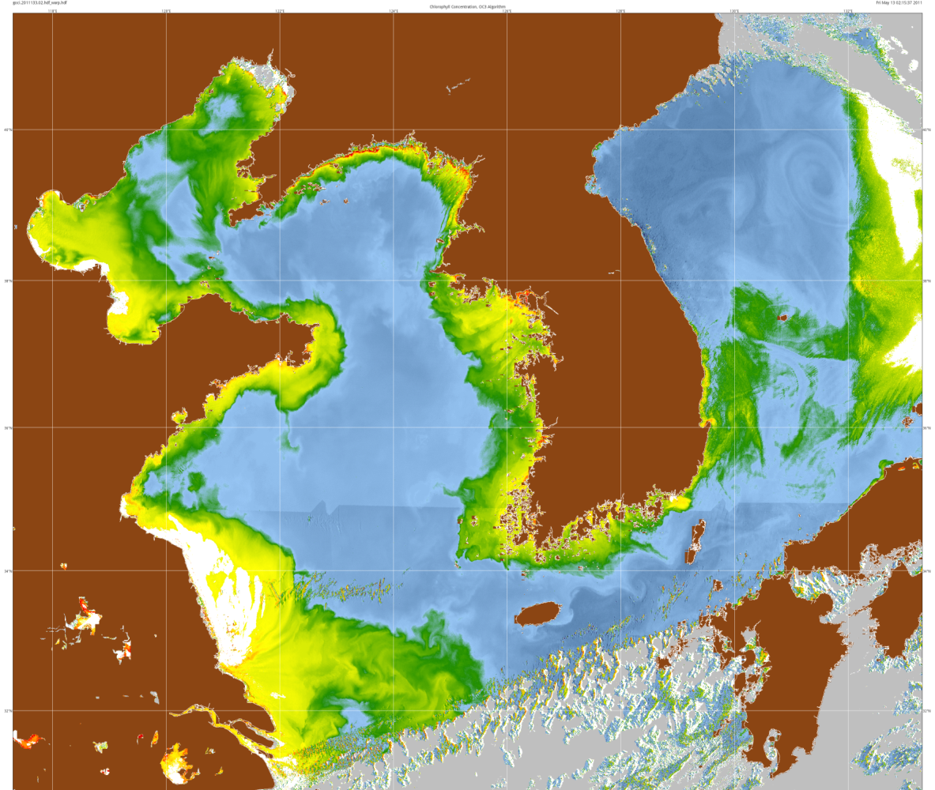
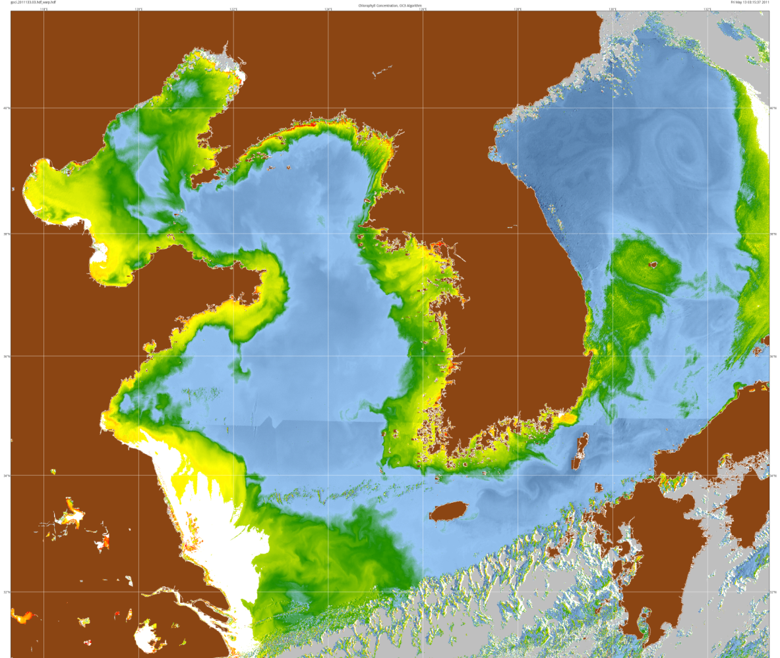
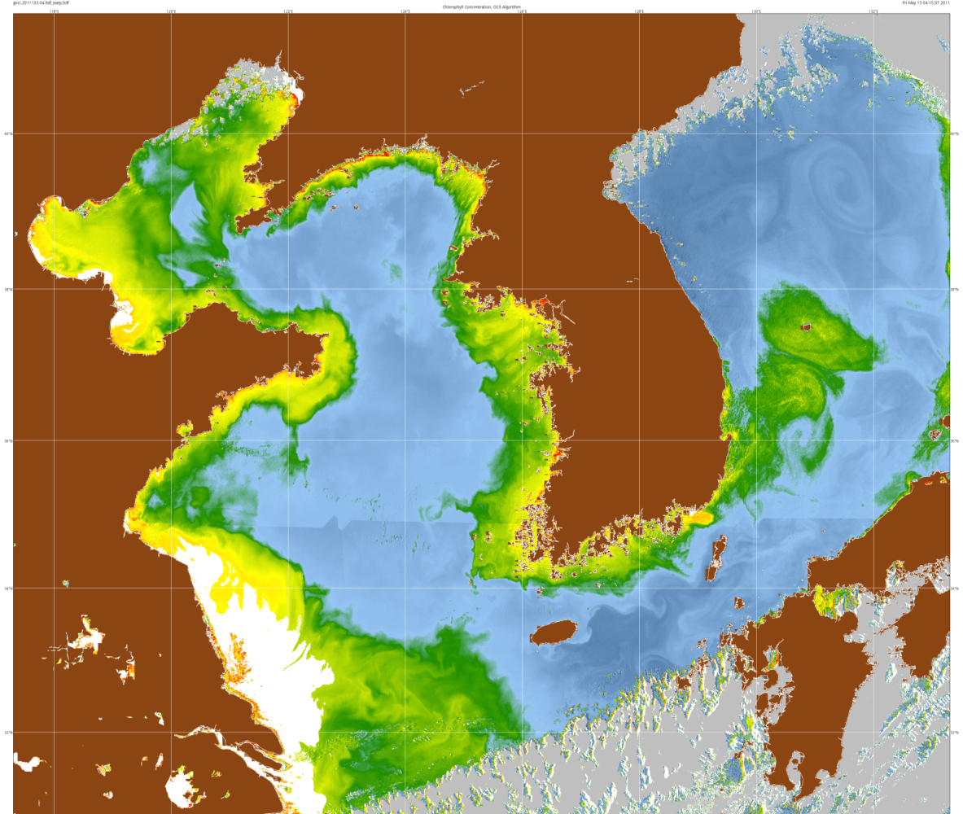
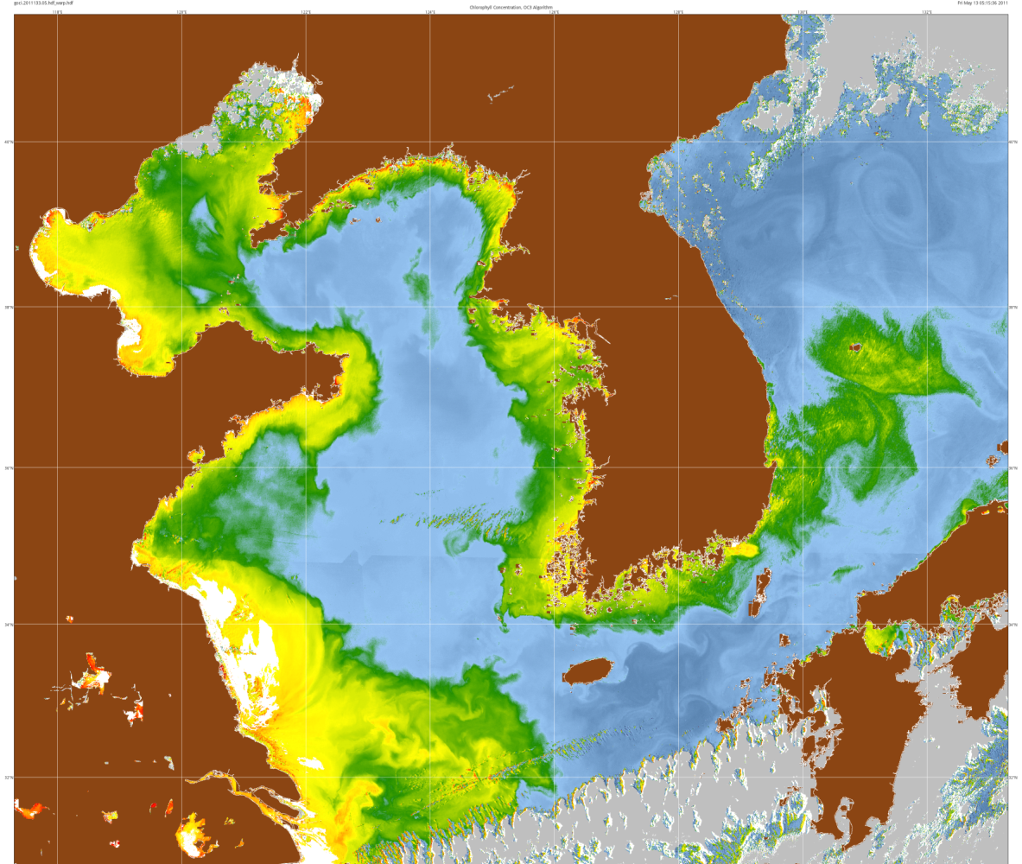
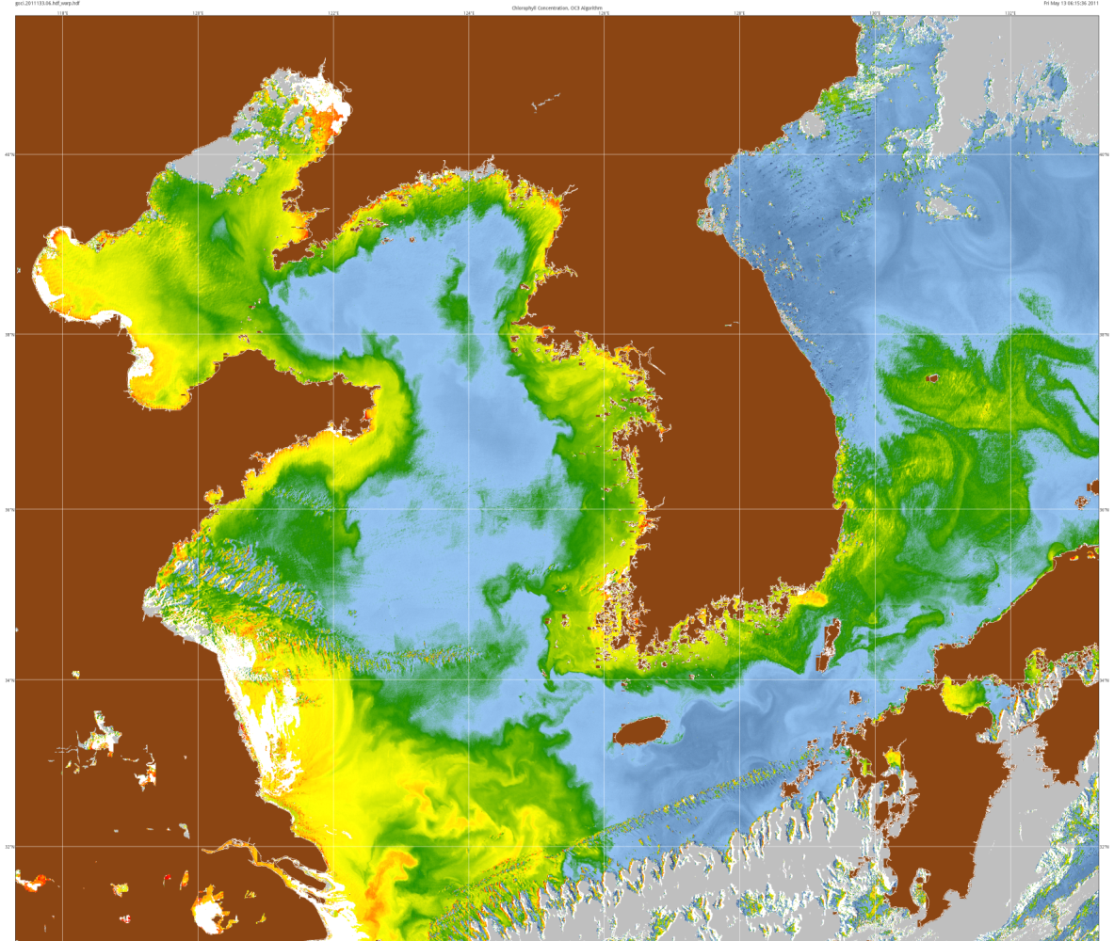
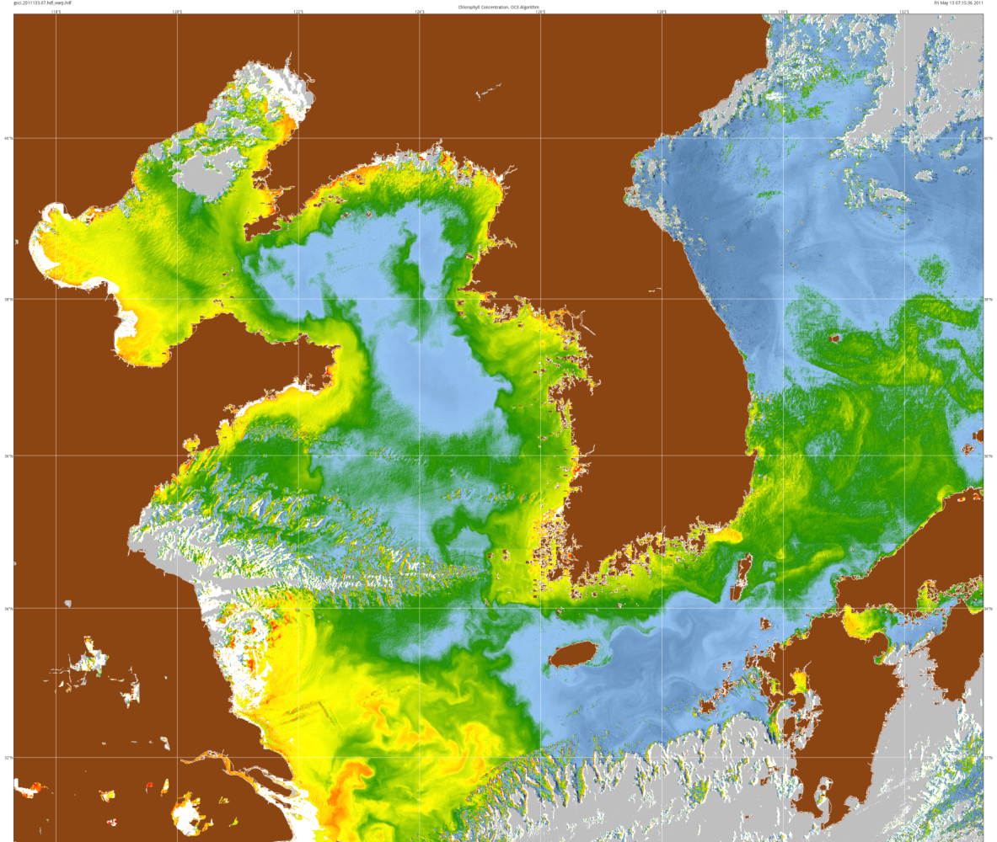
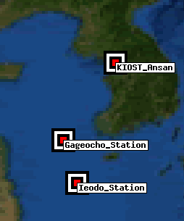
Geostationary Ocean Color Imager
Sequence
Chlorophyll
May 13, 2011
(Bob Arnone)
Flow fields
Sources and
Sinks
Japan
East Sea
Seoul
Ullung do
Island
South
Korea
Gageocho_
stations
AERONET
Korean
Strait
Cheju do
Island

Slide 23
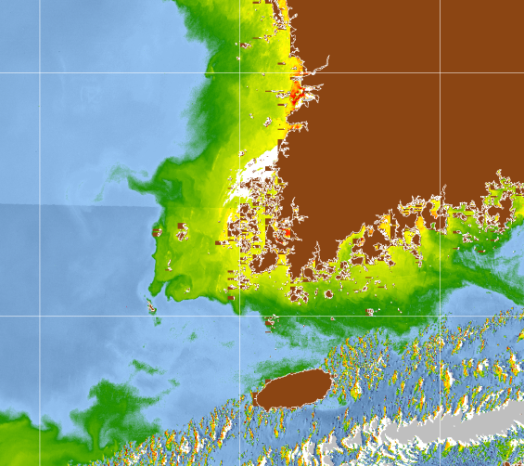
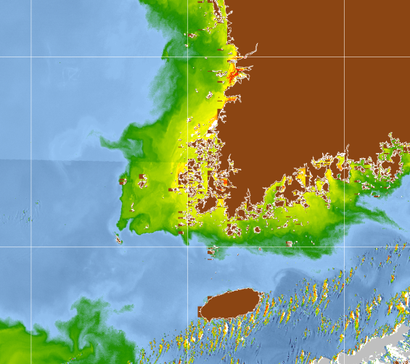
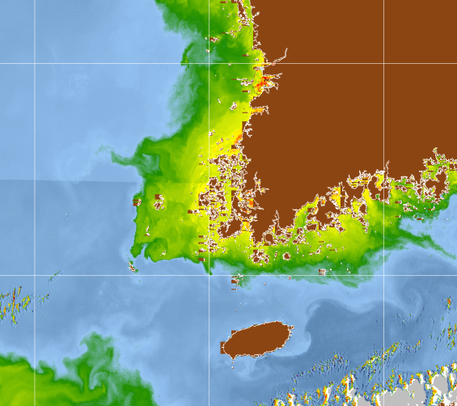
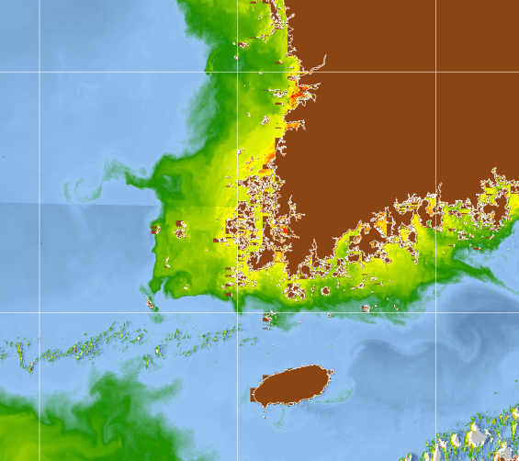
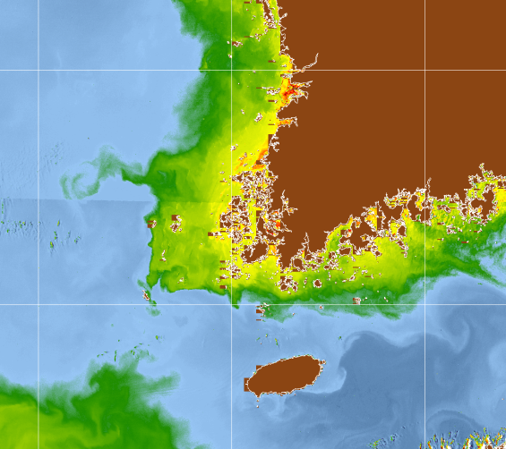
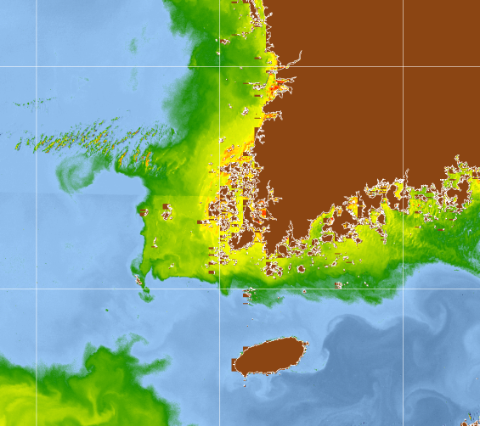
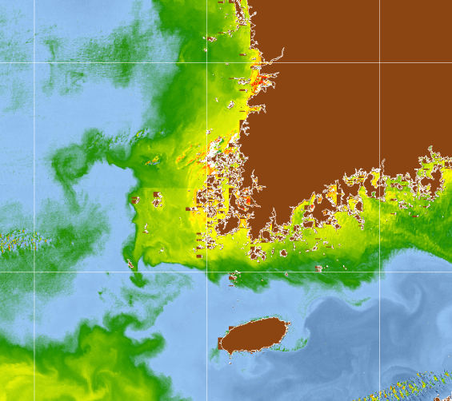
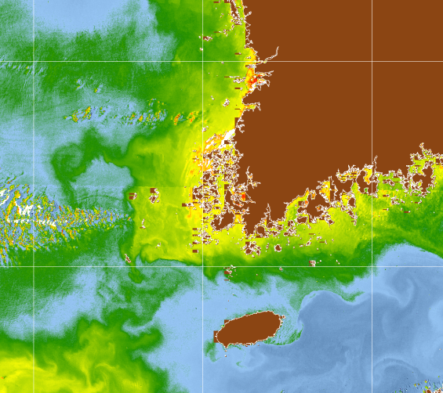
Geostationary Ocean Color Imager
8 Sequence
Chlorophyll
May 13, 2011
Tidal
Response
South
Korea
Korea Strait
Cheju do

Slide 24
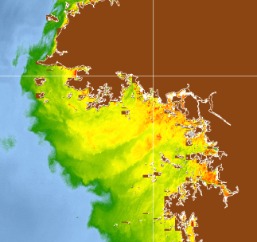
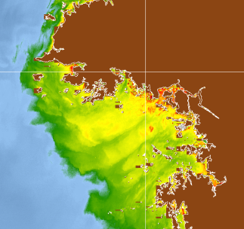
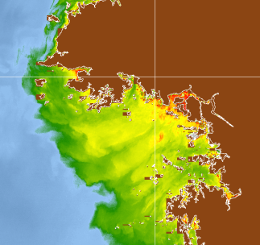
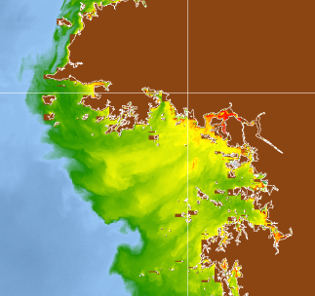
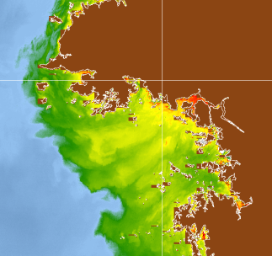
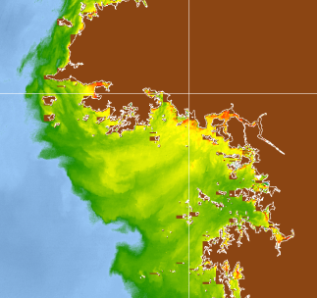
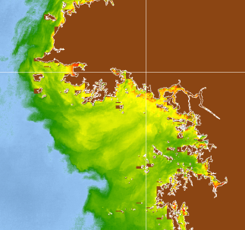
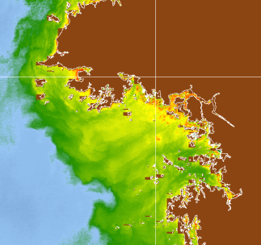
Geostationary Ocean Color Imager
Hourly Sequence
Chlorophyll
May 13, 2011
Tidal response
Along estuarine
channels
Seoul

Slide 25
Suggested shipboard measurements for KORUS

Slide 26
Korean colleagues to contribute the following measurements (TBD):
AOPs: TriOS above-water radiometry, HyperPro
IOPs: profiling ac-s, Hydroscat-6, BB-9, ...
Discrete IOPs: CDOM absorption and particle absorption (traditional QFT)
Biology/Biogeochemistry:
Coulter counter, TBD
HPLC/spectrophotometry pigments, primary productivity, flow cytometry?
SBE rosette with Go Flo bottles
Hourly rosette casts from ~8:30am to 5:30pm; stop vessel during GOCI imaging; Onnuri has 6.5 m draft
We have agreed that duplication of key measurements is acceptable, especially for AOPs and IOPs. No single-point failures for these measurements.

Slide 27
Additional Proposal Guidance (Interdisciplinary science)
B. Linking KORUS-OC Direct Surface Atmospheric Measurements (aerosols, ozone, NO2, etc.) to KORUS-AQ observations and in-water properties.
Bidirectional fluxes of constituents between the atmosphere and coastal waters
1. Examine and quantify atmospheric fluxes to coastal waters (dry and wet, direct and indirect), concentrations, bioavailability, toxicity, etc. to examine influences on biogeochemical cycling, productivity, water quality, biodiversity, etc. in the water.
2. Explore how in-water constituents, dynamics, and processes in conjunction with meteorological conditions influence fluxes to the atmosphere; quantify the spatial and temporal variability of these fluxes and examine how that variability influences the atmosphere, marine and terrestrial ecosystems.
Influences of meteorology on coastal waters and vice versa

Slide 28
Tentative budget

Slide 29
RV Onnuri
Notes:
Length (M): 63.80 Range (n. mi.): 10000 Crew: 7
Beam (M): 12.00 Endurance (days): 40 Officers: 8
Draft (M): 5.15 Cruise speed (kt): 15.0 Scientists: 25
Gross Tons: 1370 Max. speed (kt): 15.8 Air Cond.: yes
Power (HP): 3100 Aux. Power (HP): 1265
Main vessel activity
Oceanography Fisheries Geology Hydrography
Year built: 92
Ocean area where vessel operates: Pacific Ocean
Capacities and working spaces
Dry cargo holds: 0m3
Fuel: 358m3
Fresh water: 108m3
Wet laboratories (total area): 35m2
Dry laboratories (total area): 70m2
Fresh water generator capacity: 10m3
Freeboard to working deck: 2.9m
Free working deck area: 250m2
Space for container laboratory: 3m x 6m
Design Particulars
Hull materials: Steel
Energy sources
Main engine(s): number: 2 make: Diesel model:
Power (BHP) each main engine: 3100 at 900rpm
Diameter and max. rpm propeller: 3.300m 178rpm
Total power auxiliary diesels: 1265HP
Electrical systems
AC Voltage: 0/ 440V, total 1300kVA, 3phase, 60Hz
AC Voltage: 0/ 220V, total 0kVA, 0phase, 0Hz
DC Voltage: 0V, total 0V
Stabilized system for scientific equipment: 115VAC 150AMP 60Hz
Fixed equipment
Navigation and communication
Nav. equip: Radar SatNav Gyro DopLog
Comms: Fax SatCom
Comm sat:
GPS:
Acoustic
Echosounders for scientific research: 12kHz 38kHz
Sonar: Fisheries Sector-sca
Provisions for silent ship operation:
Oceanographic
Oceanographic winches: number: 0
Steel wire length: 9999m, safe working load: 10tons
Conducting cable length: 6000m, safe working load: 2tons
Trawl winch length: 0m, safe working load: 0tons
Other, specify:
length: 6000m, safe working load: 2tons
Gantry
Position: Stern, Midships
Clearance above deck: 7m and outboard extension: 3m
Safe working load at max. reach: 8tons
Crane
Position: Midships
Clearance above deck: 0m and outboard extension: 10m
Safe working load at max. reach: 1tons
Other winches for instruments or sampling:
Electronic data processing equipment permanently available on board
Computer: HEWLETT PACKARD HP 425S: :
Vessel construction and maintenance supervision
Construction supervised by:
Classification Society: KOREAN REGISTER
Others, specify:
Published vessel data
Magazine: R/V Onnuri (See Boxfile)

Slide 30
Motivating Questions
Can the diurnal changes in sediment resuspension and settling be resolved in the normalized-water leaving radiance (nLw)?
Can the diurnal dynamics in organic carbon (dissolved and particulate) due to tidal exchanges at land-ocean interfaces be resolved in nLw?
How do particle size, shape and composition impact the nLw signature at different view angles during a diurnal period?
Can diurnal change of CDOM photooxidation be detected from a geostationary satellite for all viewing geometries?
How accurate do the atmospheric properties need to be estimated in order to obtain reliable diurnal nLw from a geostationary satellite?
How does BRDF variation in water-leaving radiance (Lw, w/m²/nm/sr) affect the GOCI retrievals?
To what extent can the spatial and spectral specifications of GOCI address the diurnal variation of productivity and biogeochemical properties in the coastal oceans?

