Slide 1
SCOAPE Wx Forecast Briefing
May 10, 2019
Debra Kollonige, ESSIC/GSFC

Slide 2
SCOAPE Outlook - May 10, 2019
Cloudy and chance of rain/thunderstorms along LA coast continues Friday. A passing cold front will stall across the Lower Mississippi River valley. Widespread cloud cover will extend into Saturday (5/11).
A window for opportunity for column NO₂ validation may develop on Saturday into Sunday with scattered high clouds East of the LOOP (ie. Heavy Emissions area, Petronius & Mars/Olympus platforms).

Slide 3
Cocodrie:
Port Fourchon:
Venice:

Slide 4
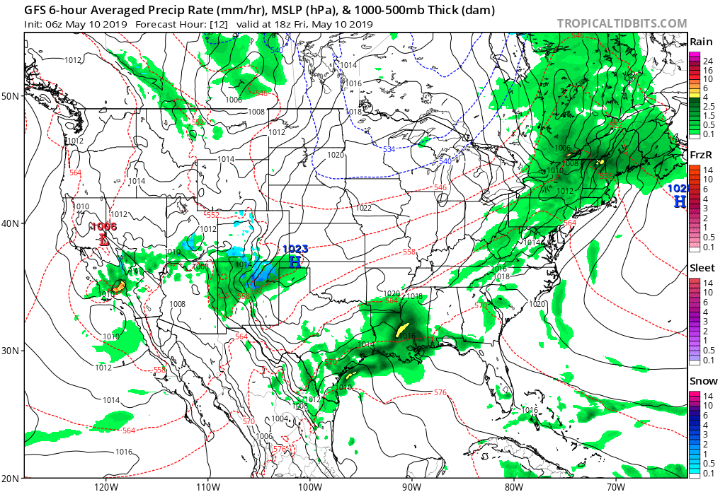
Thursday (5/9): A cold front will continue tracking southeastward across central and eastern U.S. through end of workweek, with rain and thunderstorms along and ahead of it including into the Lower Mississippi Valley. Friday (5/10): Front is expected to stall across the Southeast into the Lower Mississippi Valley and along Western Gulf Coast, so another wet day is forecast for those areas. In Cocodrie Today: A chance of showers & thunderstorms between 7am and 1pm, then showers likely and possibly a thunderstorm after 1pm. Some of storms could be severe. Mostly cloudy, with high near 82. Southeast wind 10-15 mph. Chance of precip is 60%. Tonight: A chance of showers & thunderstorms. Some storms could be severe. Mostly cloudy, low 74. Southeast wind around 10 mph, with gusts as high as 20 mph. Chance of precipitation is 40%.
GFS 1pm CDT Forecast

Slide 5
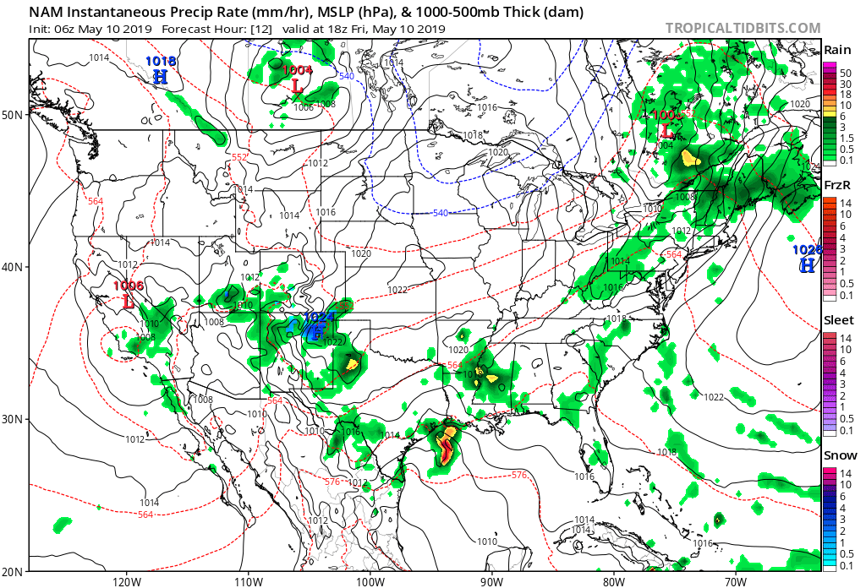
Friday, May 10, 2019
GEOS 1pm CDT Forecast
NAM 1pm CDT Forecast

Slide 6
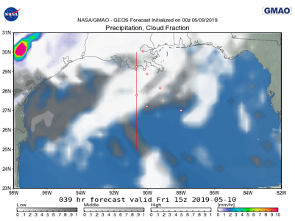
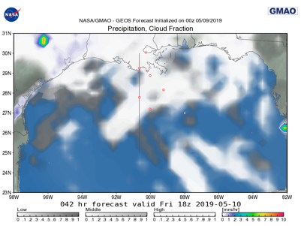
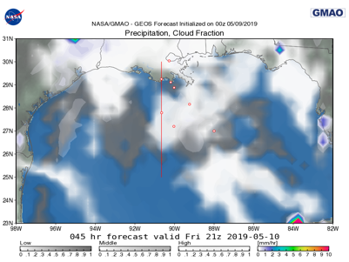
Friday, May 10, 2019
7 AM CDT
10 AM CDT
1 PM CDT
4 PM CDT

Slide 7
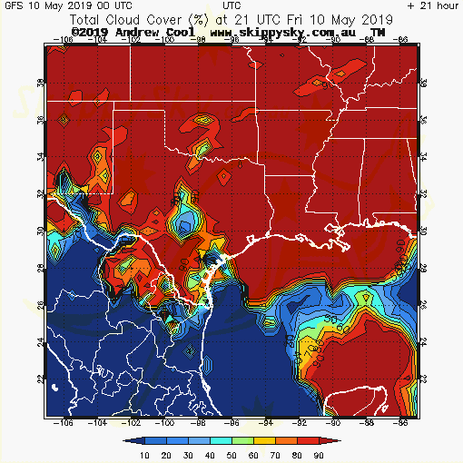
Friday, May 10, 2019
* * Max cloud cover by afternoon.
GFS Total Cloud Cover 1 PM CDT
GFS Total Cloud Cover 4 PM CDT

Slide 8
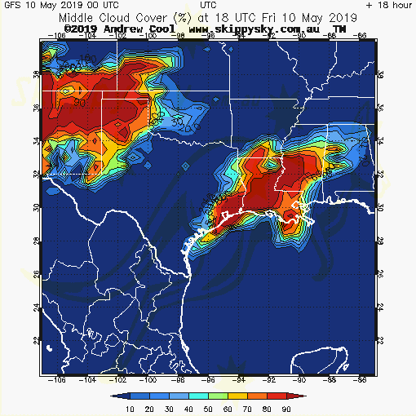
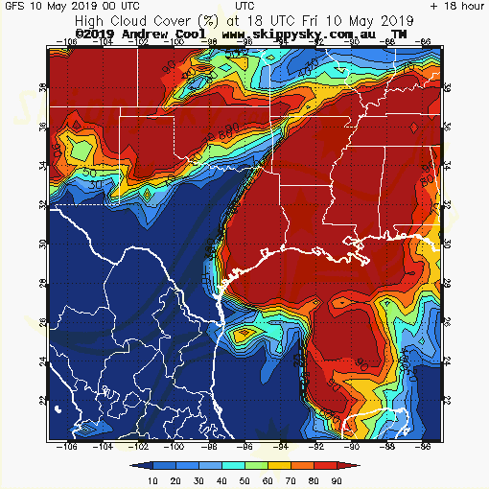
Friday, May 10, 2019
GFS Low Cloud Cover 1 PM CDT
GFS Middle Cloud Cover 1 PM CDT
GFS High Cloud Cover 1 PM CDT

Slide 9
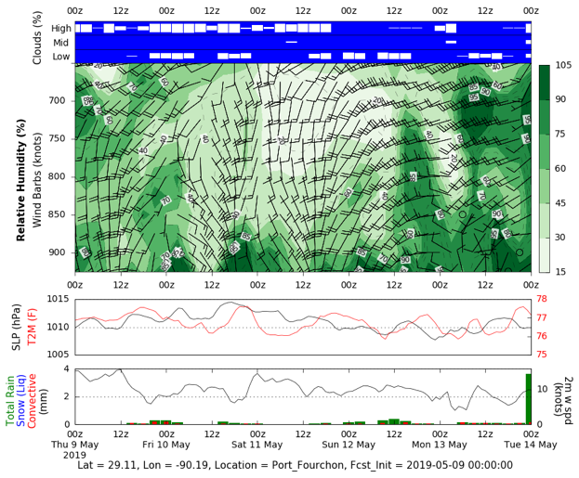
Cocodrie & Port Fourchon Datagrams (from May 9)

Slide 10
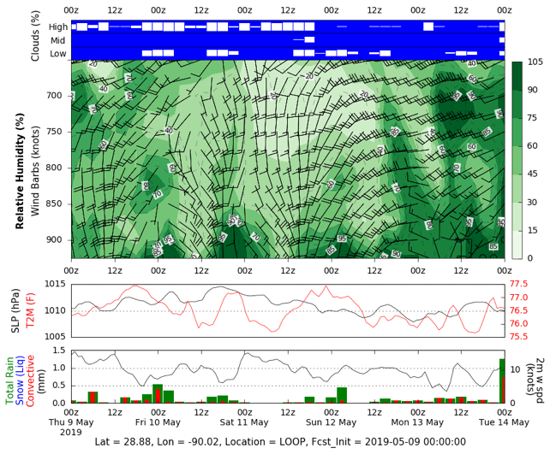
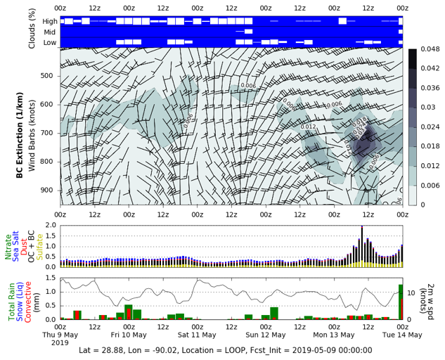
LOOP Datagrams (from May 9)

Slide 11
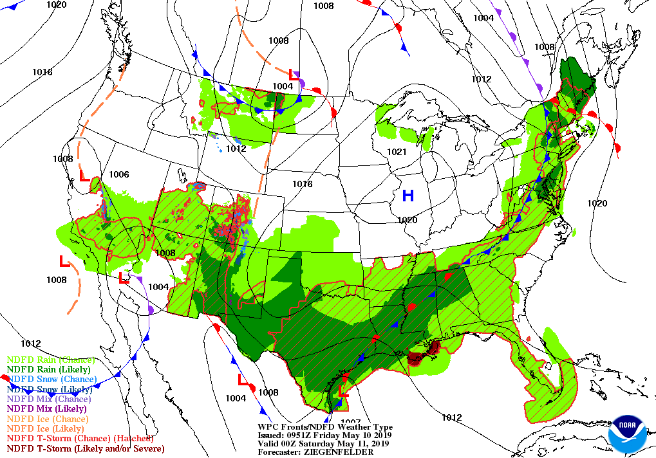
Friday: Thunderstorms likely near the coast and LOOP. Sampling may be better to the south and east.
7 AM CDT WPC Forecast
7 PM CDT WPC Forecast

Slide 12
Preliminary Cruise Track – New Suggestions
Focusing on LOOP/ shallow platforms to south and east on Friday and Saturday may be best option if cloud cover and chance of storms persist (ie. Magenta/Yellow track).
Heading to Petronius and other deep platforms by Sunday (5/12) when clouds break up next step.

Slide 13
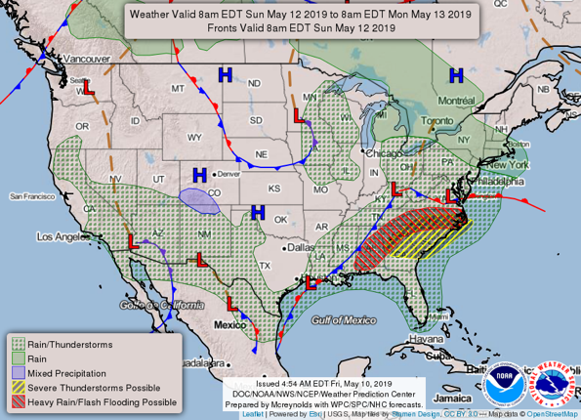
Forecast for Cocodrie: Saturday: 50 percent chance of showers & thunderstorms. Mostly cloudy, with a high near 82. South wind 10 to 15 mph. Saturday Night: 50 percent chance of showers & thunderstorms. Mostly cloudy, with a low around 74. South wind 10 to 15 mph. Sunday: Showers & thunderstorms mainly before 1pm. Partly sunny, with high near 81. Southwest wind around 15 mph. Chance of precip is 70%. Sunday Night: A chance of showers & thunderstorms before 1am, then chance of showers b/w 1am & 4am, then chance of showers & thunderstorms after 4am. Mostly cloudy, with low 68. Southwest wind 5-10 mph becoming north after midnight. Chance of precipitation is 40%. Monday: 30 % chance of showers & thunderstorms before 1pm. Mostly cloudy, with high 81. North wind 5-10 mph becoming east in afternoon. Monday Night: 20 % chance of showers & thunderstorms. Mostly cloudy, low 69. East wind around 5 mph. Tuesday: Chance of showers and thunderstorms. Partly sunny, with a high near 81. East wind around 10 mph. Tuesday Night: Chance of showers and thunderstorms. Mostly cloudy, with a low around 70. East wind around 10 mph.

